Slide 1
What is a Profession and Is Behavior Analysis One?
SHERRY L. SERDIKOFF (Savannah State University)
John M. Guercio (Benchmark Human Services)
Gordon Bourland (Trinity Behavioral Associates)

Slide 2
What is a Profession?
(When we speak of a profession)
History
  etymology of “to profess” - willingness to make a public declaration of something that was important
  16th century: special occupations of divinity, medicine, law, and (sometimes) the military
    but, people used the term to refer to everything from barbering to blacksmithing
A Brief History of Professions, n.d.
Notes:
https://pocketdentistry.com/brief-history-of-professions/#:~:text=In%20the%2016th%20century%2C%20the,everything%20from%20barbering%20to%20blacksmithing.

Slide 3
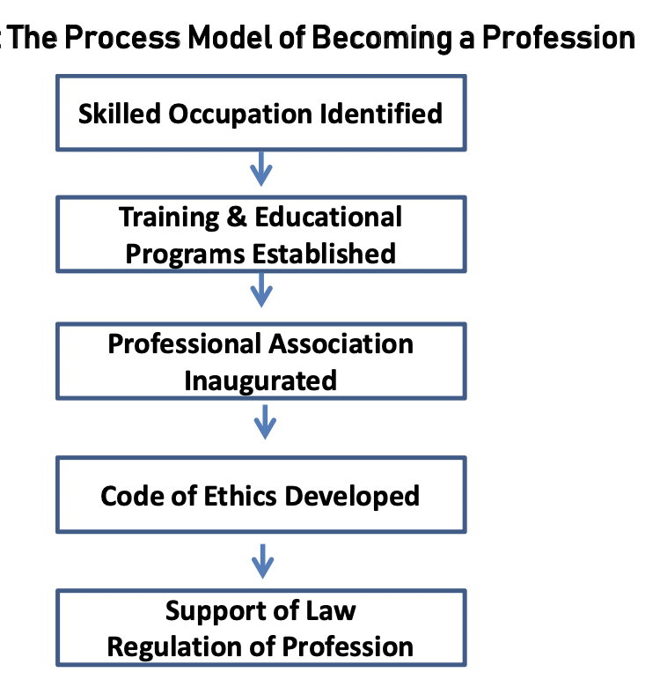
What is a Profession?
(When we speak of a profession)
History
Clarke, n.d.
Notes:
Clarke Emerging Professions- Professional Standards Council

Slide 4
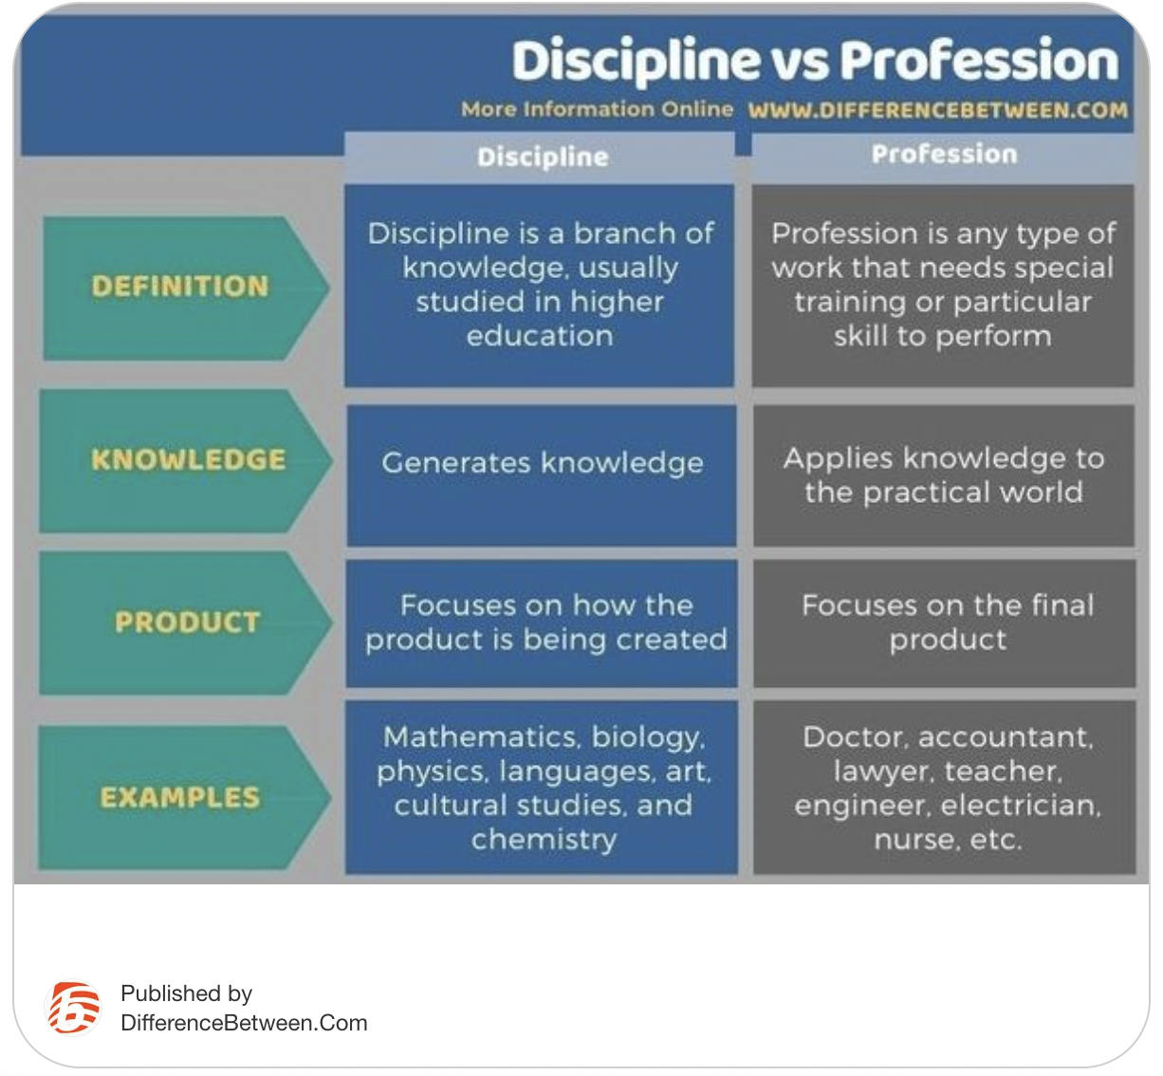
What is a Profession?
(When we speak of a profession)
Distinctions
  Professional vs. amateur
  Profession vs. occupation
  trade
  vocation
  Profession vs. discipline
Kumari, 2022
Professional Standards Councils, n.d.
Notes:
https://www.psc.gov.au/what-is-a-profession
https://www.differencebetween.com/what-is-the-difference-between-discipline-and-profession/#:~:text=Discipline%20vs%20Profession-,The%20key%20difference%20between%20discipline%20and%20profession%20is%20that%20discipline,in%20performing%20the%20particular%20job.

Slide 5
What is a Profession?
(When we speak of a profession)
Definition(s)
  ... a disciplined group of individuals who
  adhere to ethical standards and
  who hold themselves out as, and are accepted by the public as possessing special knowledge and skills in a widely recognized body of learning derived from research, education and training at a high level, and
  who are prepared to apply this knowledge and exercise these skills in the interest of others.
Australian Council of Professions, 2003
Profession, 2022
Professional Standards Councils, n.d.
Notes:
https://en.wikipedia.org/wiki/Profession;
https://www.professions.org.au/what-is-a-professional; https://www.psc.gov.au/what-is-a-profession
What-is-a-Profession-Australian-Council-of-Professions- factsheet
Abbott, A., 1988, The System of Professions: An Essay on the Division of Expert Labour, Chicago: The University of Chicago Press.

Slide 6
What is a Profession?
(When we speak of a profession)
Characteristics
  Dubois (2016), (considering medicine as prototype)
    Authority and power with respect to
    specialized knowledge, skills, capacities and services (and corresponding fees) in a context of
    ethical conduct, and
    autonomy (understood as the capacity of the community of professionals to regulate themselves)
Dubois, 2016
Notes:
Dubois (2016): https://doi.org/10.4000/asp.4784

Slide 7
Is behavior analysis one?
(When we speak of behavior analysis)
History
Behavior Analysis?
Applied Behavior Analysis?
Behavior Analytic Practice?
Clarke, n.d.
Notes:
Clarke Emerging Professions- Professional Standards Council

Slide 8
Is behavior analysis one?
(When we speak of behavior analysis)
History
  “from a developmental standpoint, a profession begins with the practice of a potentially distinctive body of expertise by a group of informally trained people.
  The expertise is viewed as having public value.
  The knowledge required of its practitioners expands with time, and
  during a long gestational interval, its members form organizations that promote their interests.
  In addition, they create systems for education, credentialing, and eventually licensure.
  The practitioners work to convince the public of their commitment and honor and of their ability to manage their problems and collegially maintain their discipline.”
A Brief History of Professions, n.d.
Notes:
https://pocketdentistry.com/brief-history-of-professions/#g4

Slide 9
Is behavior analysis one?
(When we speak of behavior analysis)
Distinction(s)
  Professional vs. amateur
  Profession vs. occupation
  Profession vs. discipline
Discipline vs Profession
  Science vs Practice
Kumari, 2022
Professional Standards Councils, n.d.

Slide 10
Is behavior analysis one?
(When we speak of behavior analysis)
Definitions
  APA Division 25: Behavior analysis is a natural science that seeks to understand the behavior of individuals and to apply this understanding in a wide range of settings.
  ABAI: Behavior analysis is a natural science that seeks to understand the behavior of individuals.
  BACB: Behavior analysis is the science of behavior, with a history extending back to the early 20th century.
  APBA: Behavior analysis is a scientific discipline whose subject matter is individual behavior interacting with environmental events.
ABAI, n.d.
APBA, n.d.
BCBA, n.d.
Div 25 APA, n.d.
Notes:
https://www.abainternational.org/about-us/behavior-analysis.aspx
https://www.apbahome.net/page/aboutba
https://www.bacb.com/about-behavior-analysis/
https://www.apadivisions.org/division-25/index?_ga=2.144597809.560634747.1653333802-1853861913.1649109667&_gac=1.189007321.1651517983.CjwKCAjwgr6TBhAGEiwA3aVuIZQrU5lVVT6pOkfAnfL95irf2TYPbDcV1cZvFwycJvsggPx1Mmqr-BoCXpwQAvD_BwE

Slide 11
Is behavior analysis one?
(When we speak of behavior analysis)
Distinction(s)
  Professional vs. amateur
  Profession vs. occupation
  Profession vs. discipline
Discipline vs Profession
  Science vs Practice
  Science and Practice ?
Kumari, 2022
Professional Standards Councils, n.d.

Slide 12
Is behavior analysis one?
(When we speak of behavior analysis)
Characteristics
  Dubois (2016), considering medicine as prototype
    Authority and power with respect to
    specialized knowledge, skills, capacities and services (and corresponding fees) in a context of
    ethical conduct, and
    autonomy (understood as the capacity of the community of professionals to regulate themselves)
      Possible limits to or challenges to autonomy
        Composition of oversight boards, commissions, etc
        Who has the last say regarding profession regulations?
Notes:
Dubois (2016): https://doi.org/10.4000/asp.4784

Slide 13
Is behavior analysis one?
(When we speak of behavior analysis)
    Regarding autonomy of behavior analysis consider:
      Composition of licensing board/commission/etc- diversity?
        variety of perspectives in field, employment of members, geographic representation, representatives from other professions, consumer participation
      Ultimate decision maker(s)?

Slide 14
A Discipline and a Profession?
Psychology is scientific discipline that studies mental states and processes and behavior in humans and other animals. The discipline of psychology is broadly divisible into two parts: a large profession of practitioners and a smaller but growing science of mind, brain, and social behavior.
Social work is a practice-based profession and an academic discipline that promotes social change and development, social cohesion, and the empowerment and liberation of people.
Nursing is a discipline and a profession. The goal of the discipline is to expand knowledge about human experiences through creative conceptualization and research. The goal of the profession is to provide service to humankind through living the art of the science.
Behavior analysis?
  ABAI: “Home of the science and practice of behavior analysis.”
  APBA: ...has theoretical, experimental, and applied branches
    Complicated by multiple ways we use the term?
International Federation of Social Workers, 2022
Mischel, n.d.
Parse, 1999
Notes:
https://www.ifsw.org/what-is-social-work/global-definition-of-social-work/
https://www.britannica.com/science/psychology
Parse: Nursing Science Quarterly, Vol. 12 No. 4, October 1999, 275-276

Slide 15
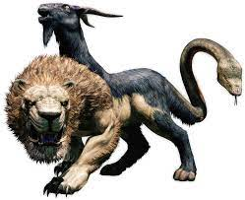
A Discipline and a Profession?
Discipline and Profession- common core of philosophy, general mission, knowledge, and values with diversity present and possessing the essential features of a profession
or
Chimera- combination of features that are not integrated and that probably is unlikely to survive

Slide 16
Concluding Remarks
What is a profession?
Is behavior analysis one?
Does it matter?
Some other important matters
  Different status across social and national contexts?
Notes:
Different status- what if few behavior analysts live in a nation or region? What about different cultures values regarding helping others, helping professions, and science?
Does it matter? Consider protection of the public, sustaining the discipline/science/ occupation (versus overshadowed by some other profession), practitioners able to earn a living?

Slide 17
References
A Brief History of Professions (n.d.). Pocket Dentistry. https://pocketdentistry.com/brief-history-of-professions/#:~:text=In%20the%2016th%20century%2C%20the,everything%20from%20barbering%20to%20blacksmithing.
American Psychological Association Division 25 (2022). About Division 25. Retrieved May 23, 2022 from https://www.apadivisions.org/division-25/index?_ga=2.144597809.560634747.16533338021853861913.1649109667&_gac=1.189007321.1651517983.CjwKCAjwgr6TBhAGEiwA3aVuIZQrU5lVVT6pOkfAnfL95irf2TYPbDcV1cZvFwycJvsggPx1Mmqr-BoCXpwQAvD_BwE
Association for Behavior Analysis International (2022). What is Behavior Analysis? https://www.abainternational.org/about-us/behavior-analysis.aspx
Association for Professional Behavior Analysts (n.d.). About Behavior Analysis. https://www.apbahome.net/page/aboutba
Behavior Analyst Certification Board (2022). About Behavior Analysis. https://www.bacb.com/about-behavior-analysis/
Clarke, T. (n.d.). Emerging Professions. Professional Standards Councils. Retrieved May 20, 2022 from https://www.psc.gov.au/sites/default/files/2021-08/1c.%20Emerging%20Professions_0.pdf
Dubois, M. (2016). Science as vocation? Discipline, profession and impressionistic sociology, ASp [Online], 69, https://doi.org/10.4000/asp.4784
International Federation of Social Workers (2022). Global Definition of Social Work. https://www.ifsw.org/what-is-social-work/global-definition-of-social-work/
Kumari, G. (2022, February 14). What is the Difference Between Discipline and Profession. Retrieved May 20, 2022 from https://www.differencebetween.com/what-is-the-difference-between-discipline-and-profession/#:~:text=Discipline%20vs%20Profession-,The%20key%20difference%20between%20discipline%20and%20profession%20is%20that%20discipline,in%20performing%20the%20particular%
Mischel, W. (n.d.). Psychology. Britanica https://www.britannica.com/science/psychology
Parse, R. R. (1999). Nursing: The Discipline and the Profession. Nursing Science Quarterly, 12 (4), 275-276
Profession. (2022, May 20). In Wikipedia. https://en.wikipedia.org/wiki/Profession
What is a Profession (n.d.). Professional Standards Councils. Retrieved May 20, 2022 from https://www.psc.gov.au/what-is-a-profession
What is a Profession (2003). Australian Council of Professions Retrieved 2022, May 20 from https://www.professions.org.au/what-is-a-professional/

