Slide 1
Opposition to Licensure of Behavior Analysts:
Who Objects and Why?
John W. Scibak, Ph.D.
Massachusetts Legislature (Retired)
ABAI Licensure Committee

Slide 2
History of Licensure
Dent v. West Virginia (1889)
  States can set standards for occupations to protect citizens from the ”consequences of ignorance and incapacity as well as deception and fraud”.
Approximately 23.5% of the U.S. civilian labor force hold a license or certificate in their profession, up from 5% in the 1950’s
Significant disparities across states regarding professions that are licensed
  Florist – Louisiana
  Gas Station Pumpers – New Jersey
  Home Entertainment Installers – Massachusetts, Connecticut, Louisiana

Slide 3
Licensing/Certification of
Behavior Analysts
MABA Executive Council (1977)
  Recommended the development of a certification program for its members which never really got off the ground
ABA Executive Council (1987)
  Suspended the program and appointed Jerry Shook to chair a task force on credentialing, which ultimately resulted in the incorporation of the BACB in 1998.
  The BCBA became the de facto credentialing standard for behavior analysts
Licensure was not an issue until 2007
  Bills were filed in Arizona, Massachusetts and Pennsylvania
  Pennsylvania became the first state to license “Behavior Specialists” in 2008 and Arizona was the first state to license “Behavior Analysts” later that year.

Slide 4

Massachusetts Licensing Bill Experience
Sausage Making at Its Best

Slide 5
Massachusetts Experience
Behavior analysts placed under Board of Registration for Psychologists
  Rejected by Psychologists
  Behavior Analysts wanted their own separate Board
Disagreements Abound
  Between Psychologists and Behavior Analysts (Technicians)
  Between Behavior Analysts Themselves (Certification vs. Licensure)
Proposed behavior analysts as a separate Board during subsequent legislative session
  Rejected by Psychologists who saw behavior analysts as a new revenue stream which could possibly reduce licensing
  Rejected by Executive Branch until sufficient number of licensees was achieved
Board Composition

Slide 6
Massachusetts Experience
Scope of Practice Provisions
  Exemptions for Other Disciplines (Speech-Language Pathology, Occupational Therapy, Physical Therapy, Psychology)
  Mandatory referrals from a psychologist prior to seeing a behavior analyst
Eligibility Criteria
  BACB
  Approved Course Sequencing
  Grandfathering Sequencing
Lobbyists Weigh In
  Impact on other disciplines
  Impact on state institutions, public school systems, and provider agencies/organization

Slide 7
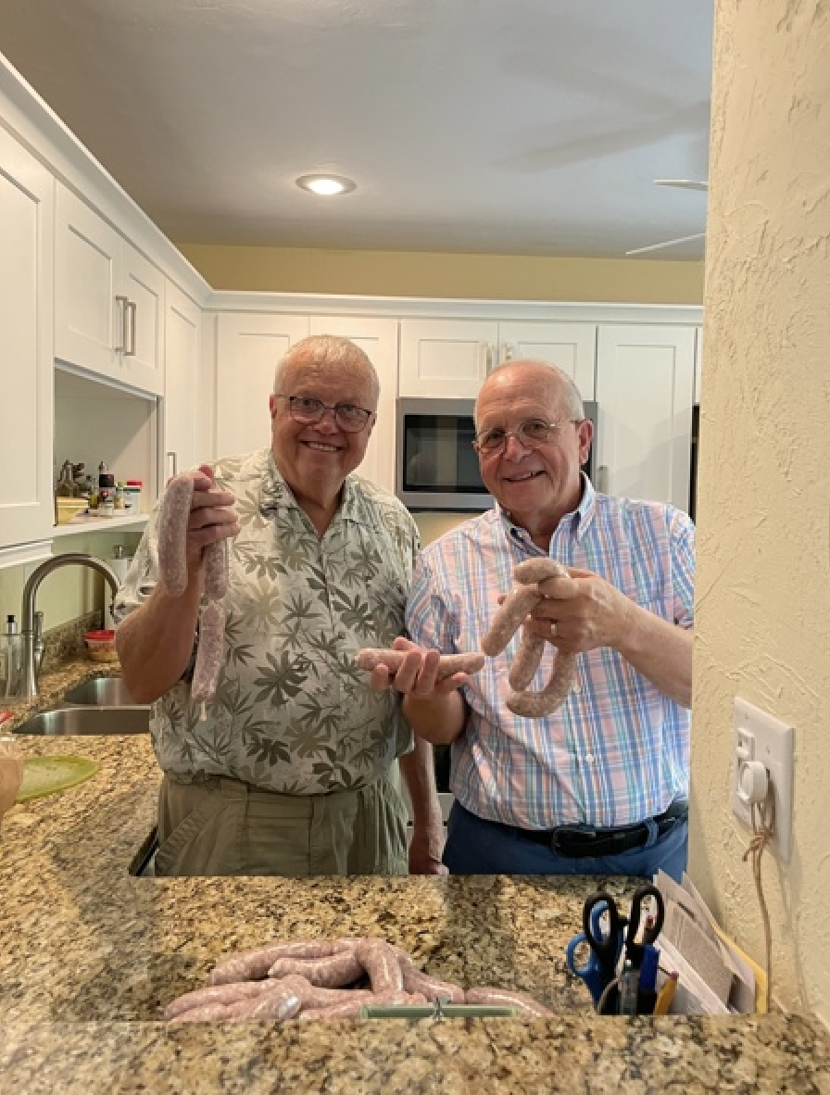
Massachusetts Licensing Bill Experience
The Finished Product
Chapter 429 of the Acts of 2012 was signed on January 8, 2013, six years after the first bill was filed

Slide 8
Objections to Licensure for Behavior
Analysts
Increases the Cost of Services
Libertarians
Impinges on Scope of Practice of Other Disciplines
Loss of Revenue for Other Licensed Professions
Ethical Objections to the Practice of Applied Behavior Analysis
Restrict Access to Care
Applied Behavior Analysis has too narrow a focus

Slide 9
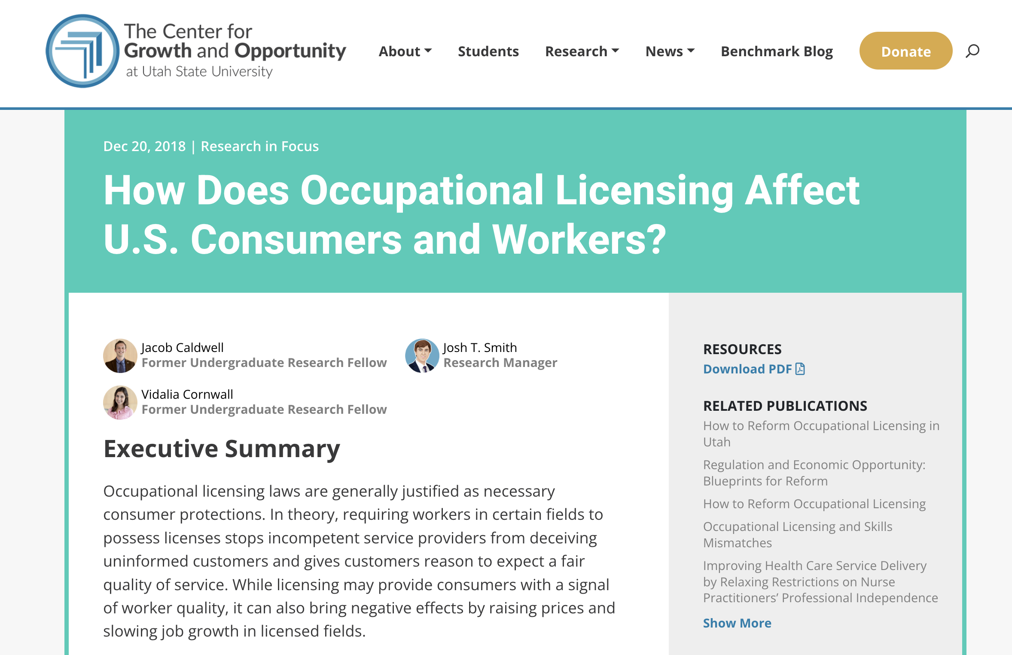
Objections to Licensure for Behavior
Analysts
Increases the Cost of Services
  Additional costs for practitioners (licensing fees) and consumers (fees for service)

Slide 10
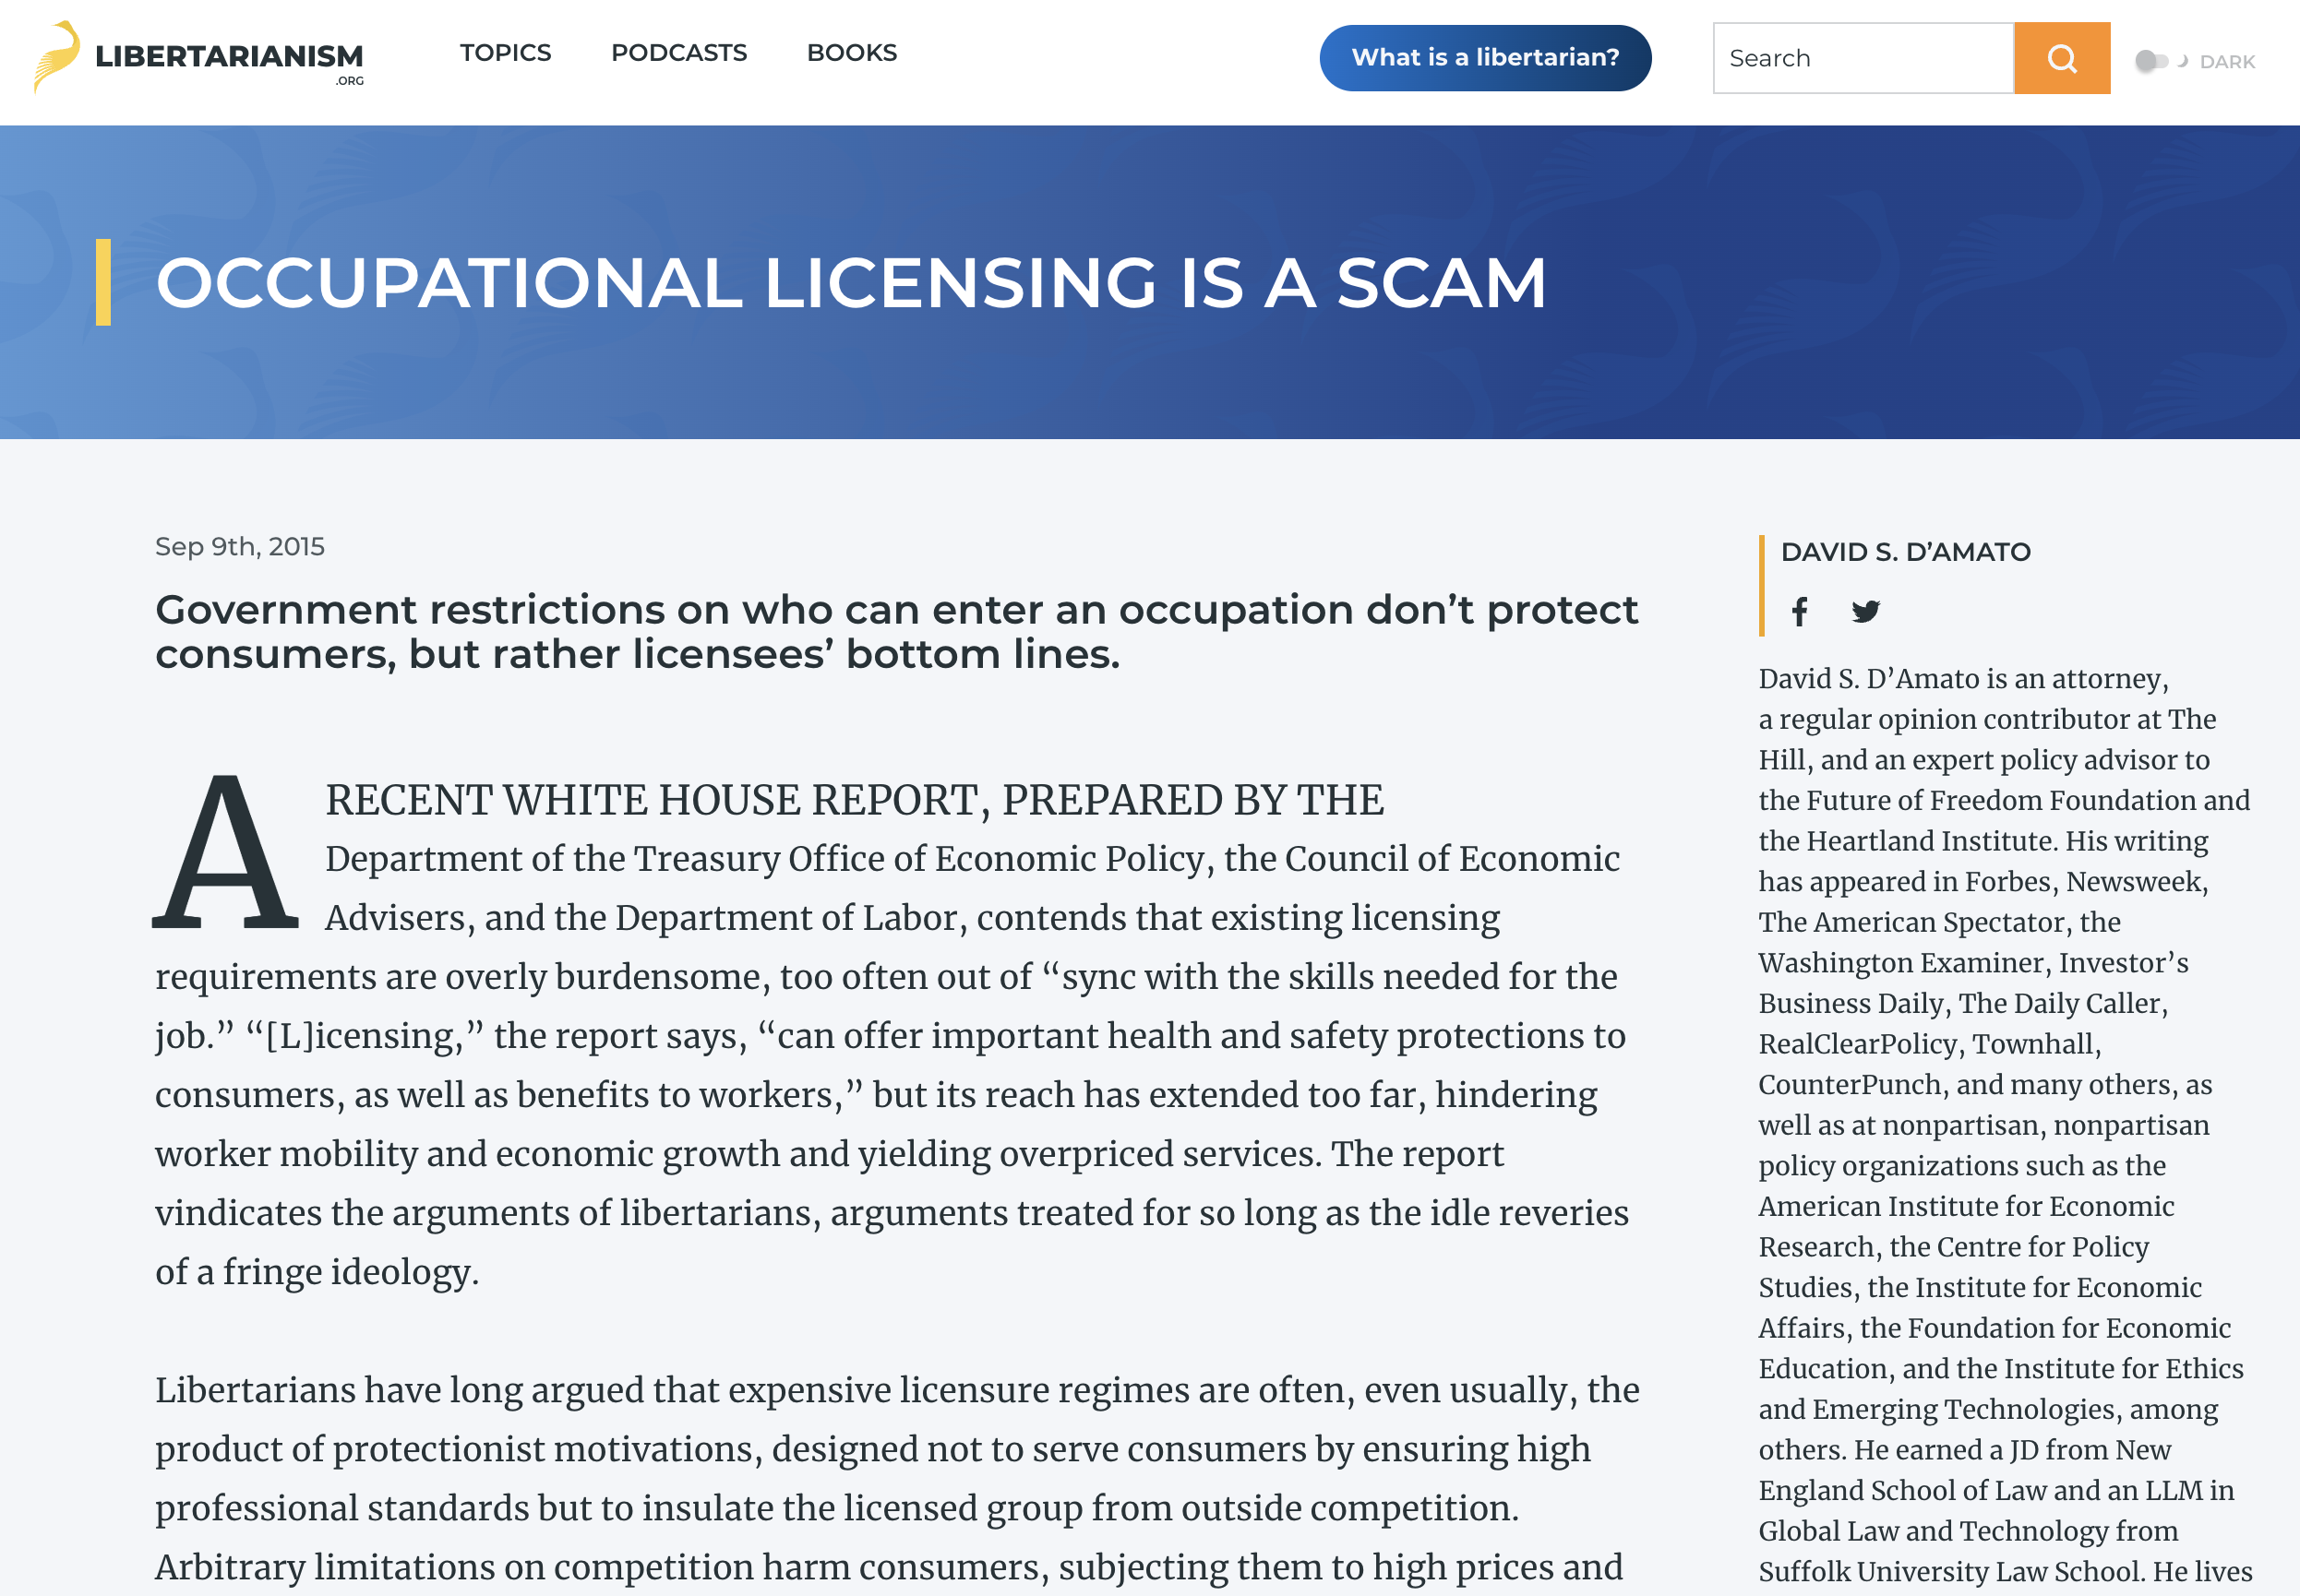
Objections to Licensure for Behavior
Analysts
Libertarians
  Licensure doesn’t serve consumers but protects licensed groups from outside competition

Slide 11

Objections to Licensure for Behavior
Analysts
Impinges on Scope of Practice of Other Disciplines

Slide 12
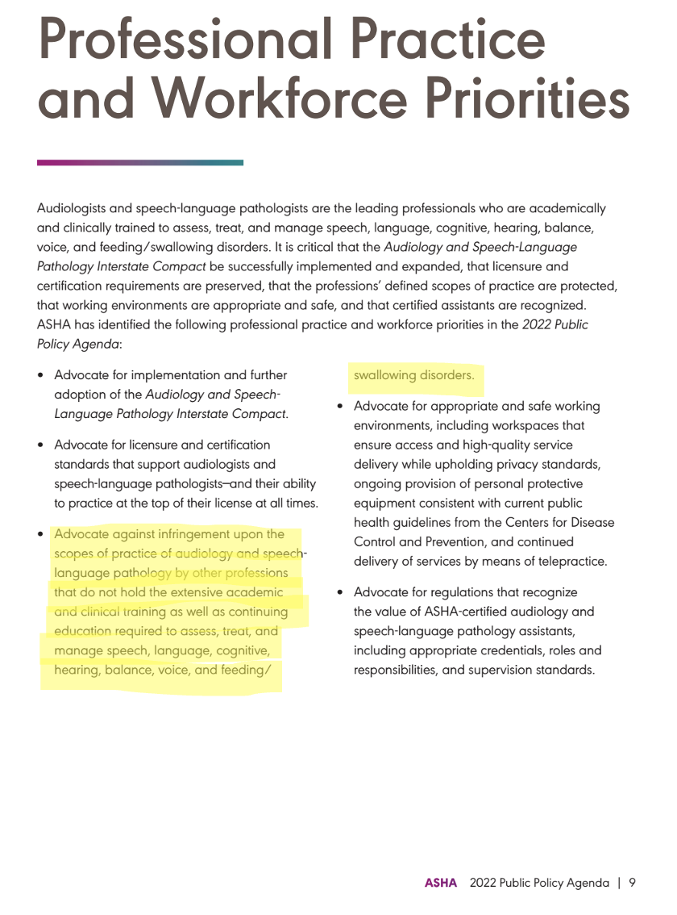

Slide 13
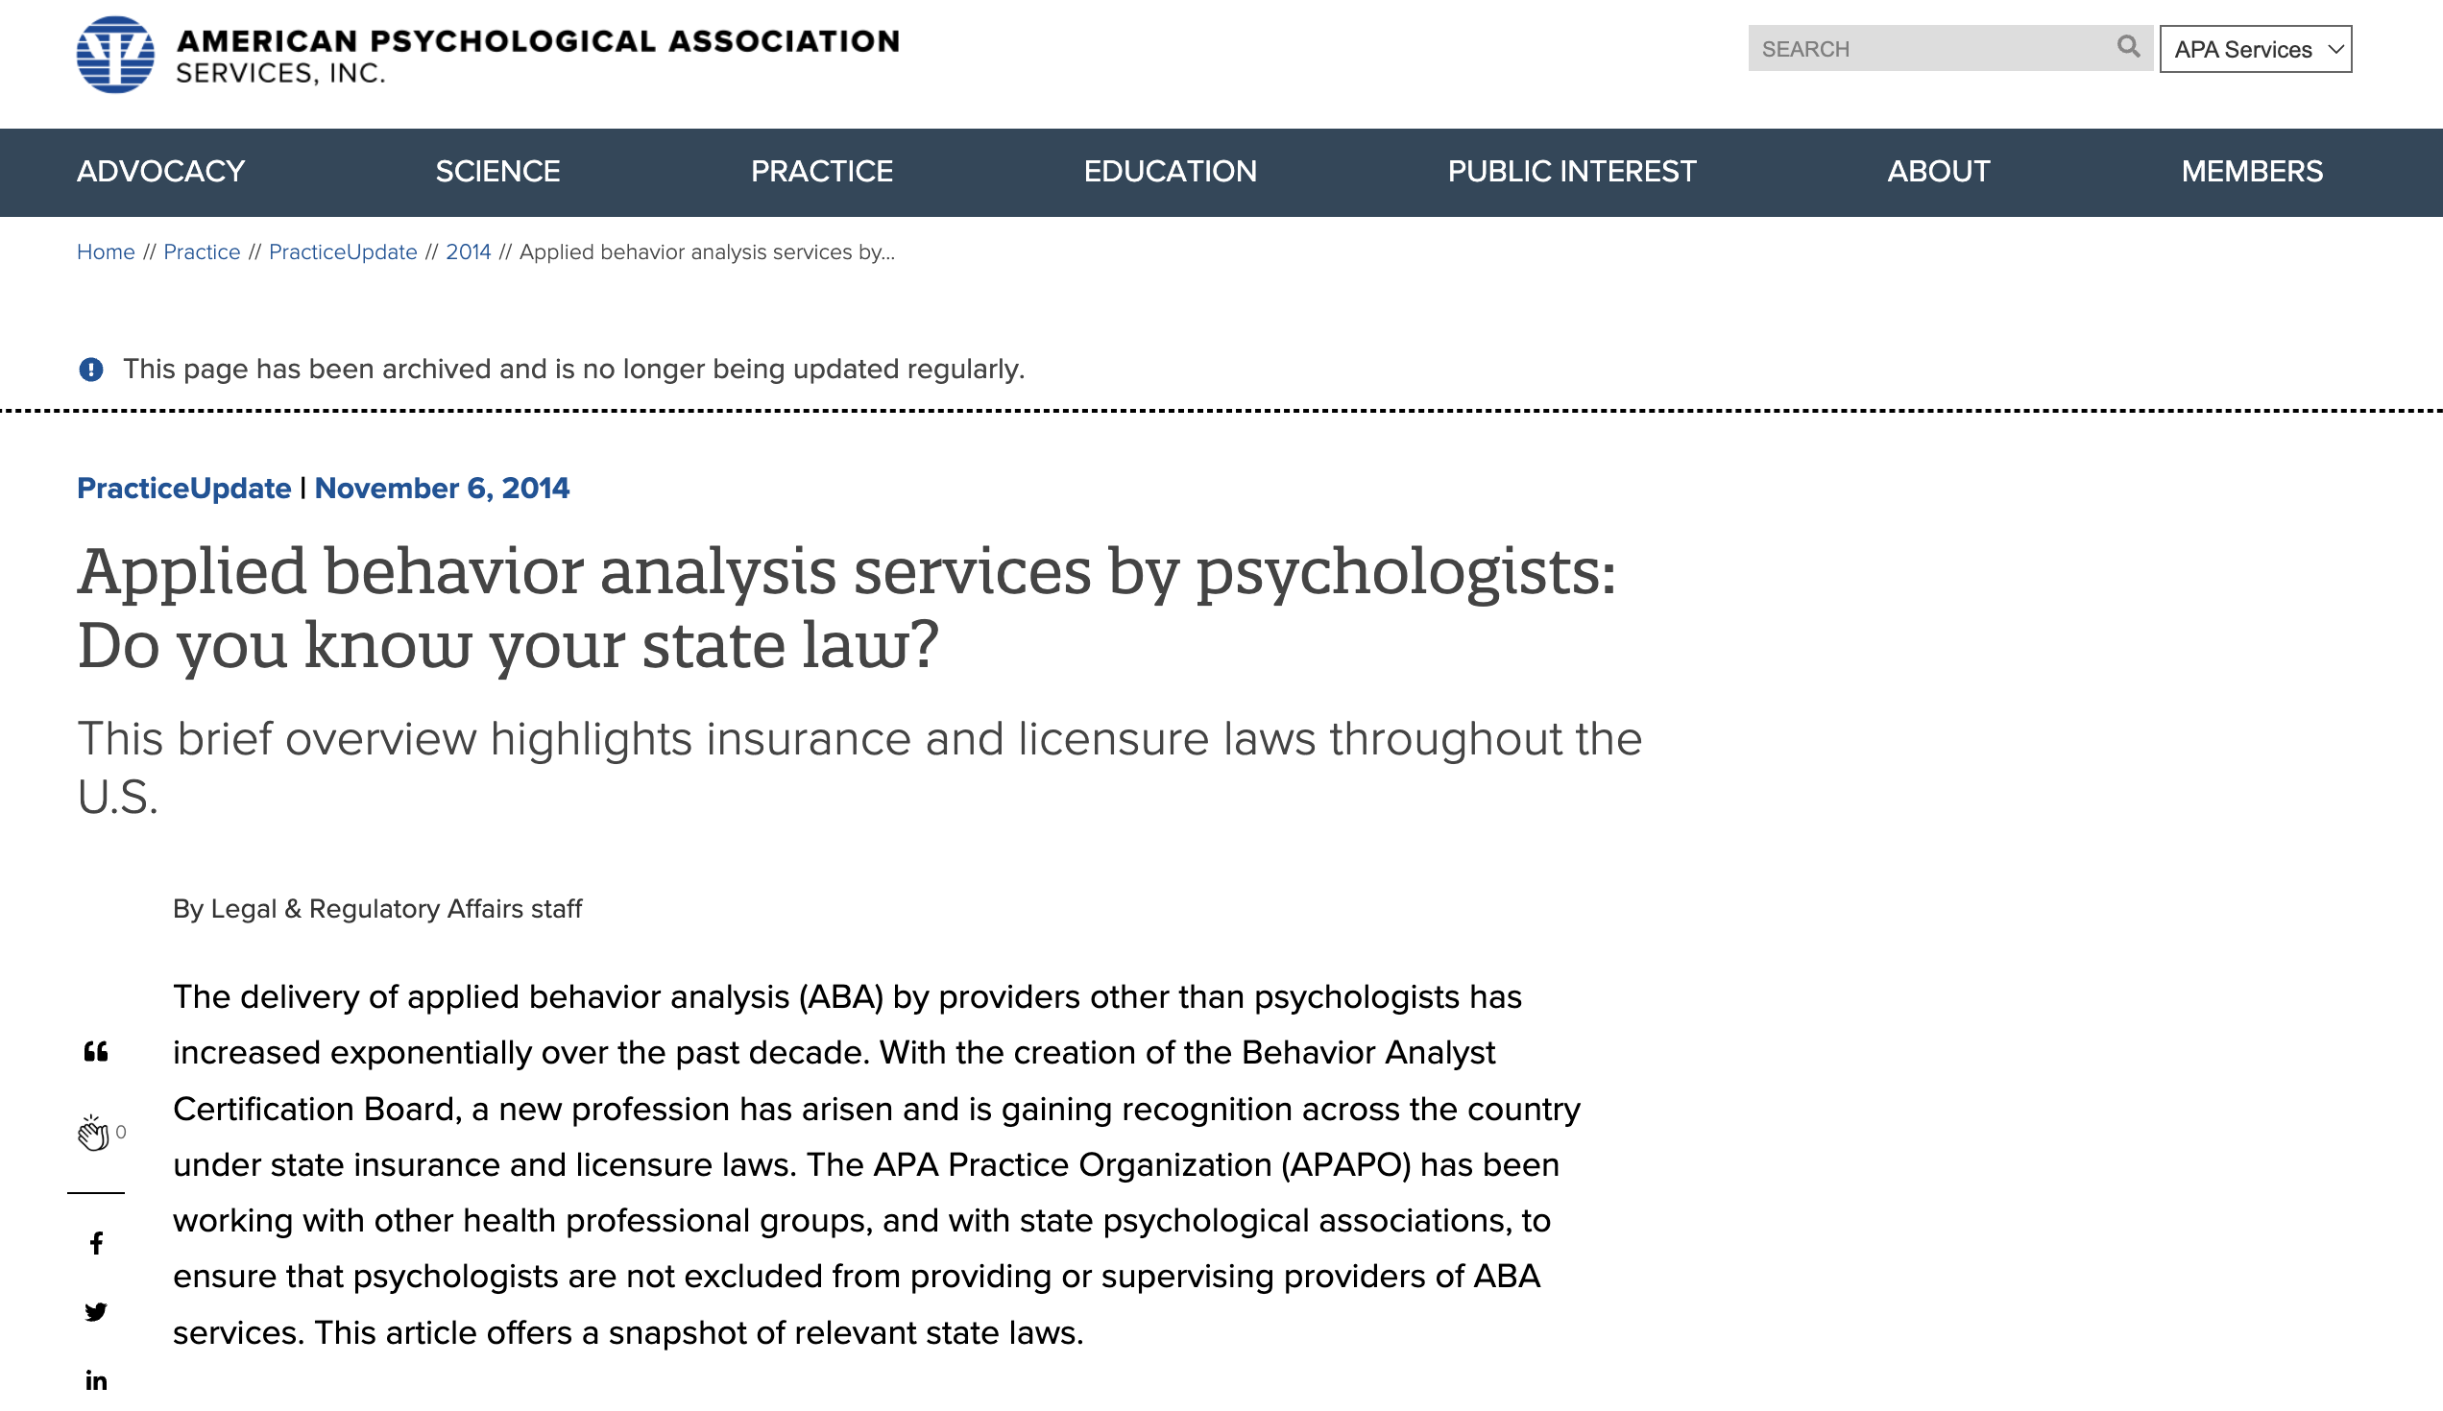

Objections to Licensure for Behavior
Analysts
Loss of Revenue for Other Licensed Professions
  Licensing under Psychology generates more revenue for Board, AND
  Supervision by psychologists provides for revenue for individual clinicians

Slide 14
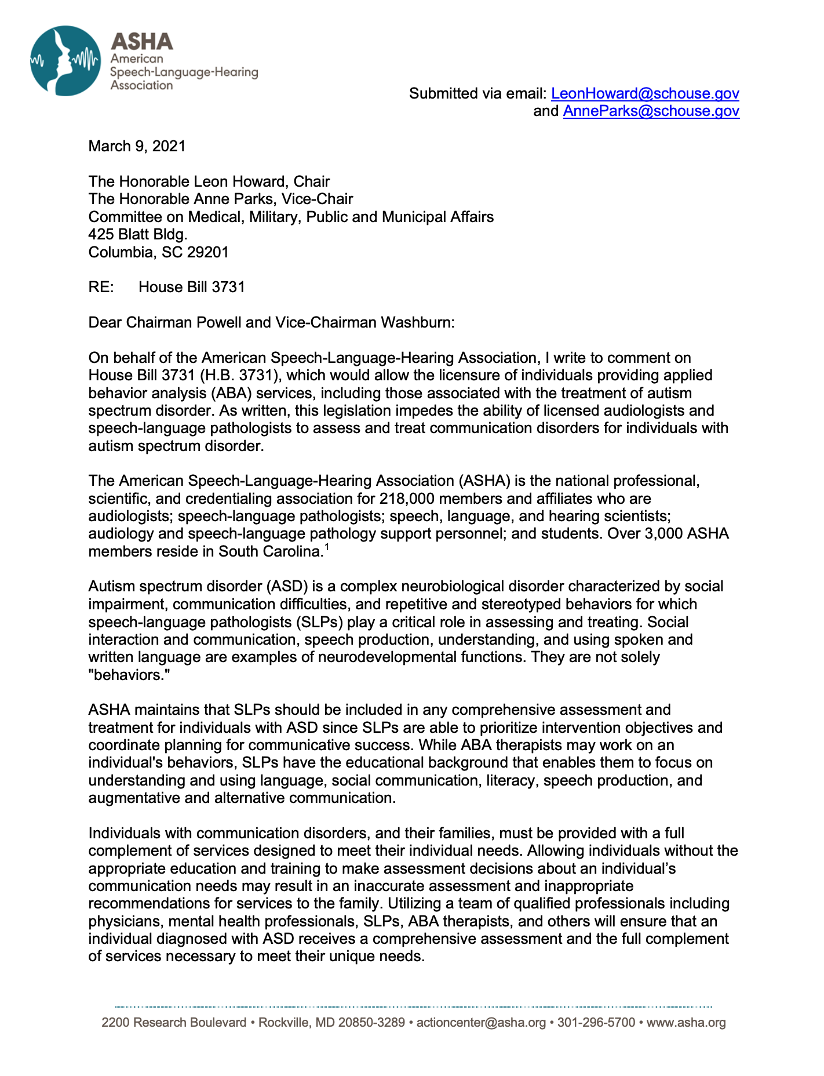

Slide 15
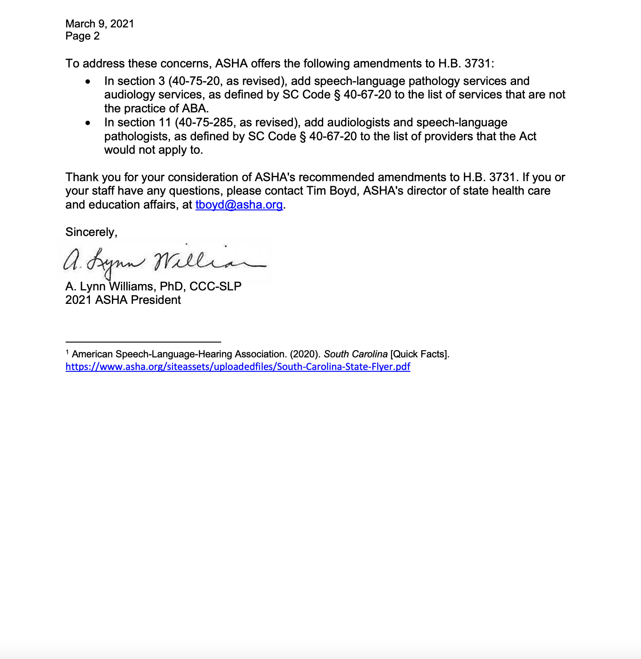

Slide 16
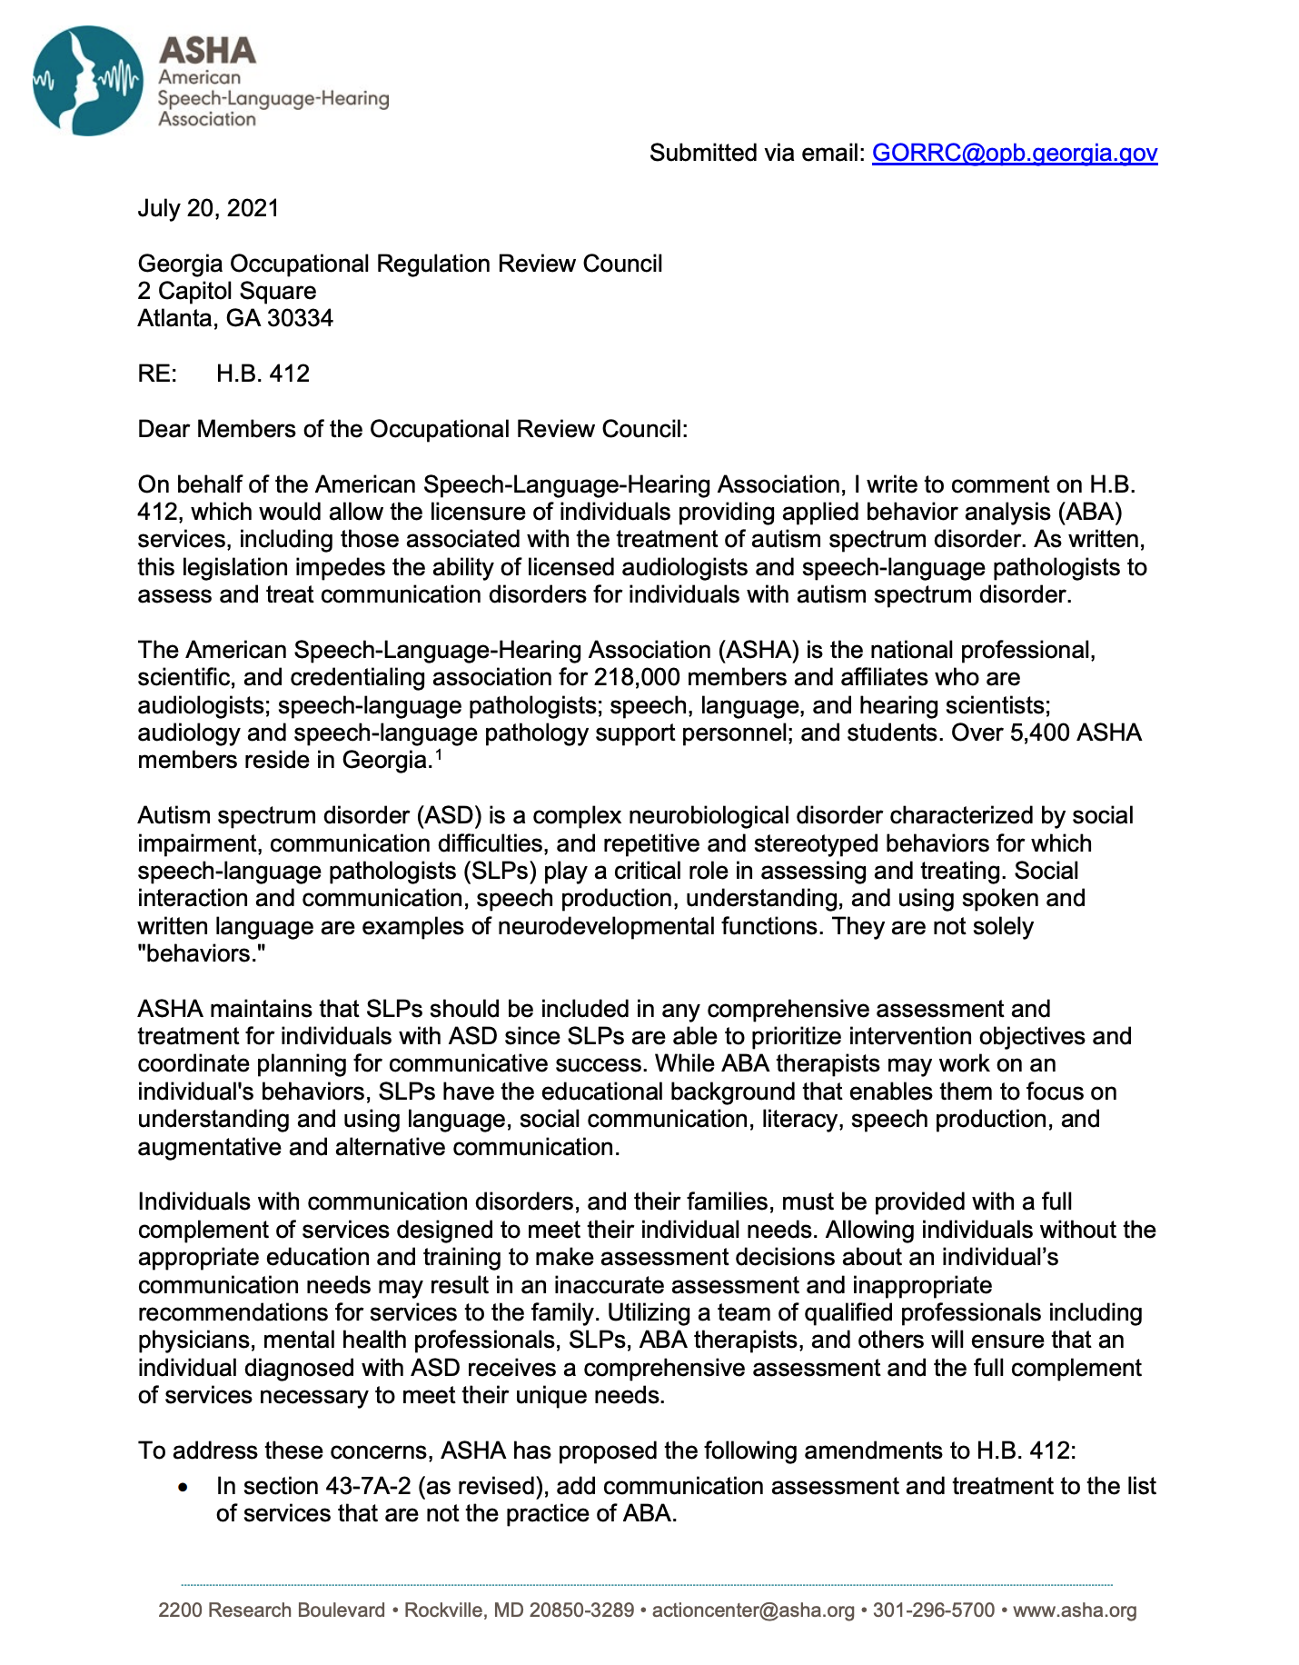

Slide 17
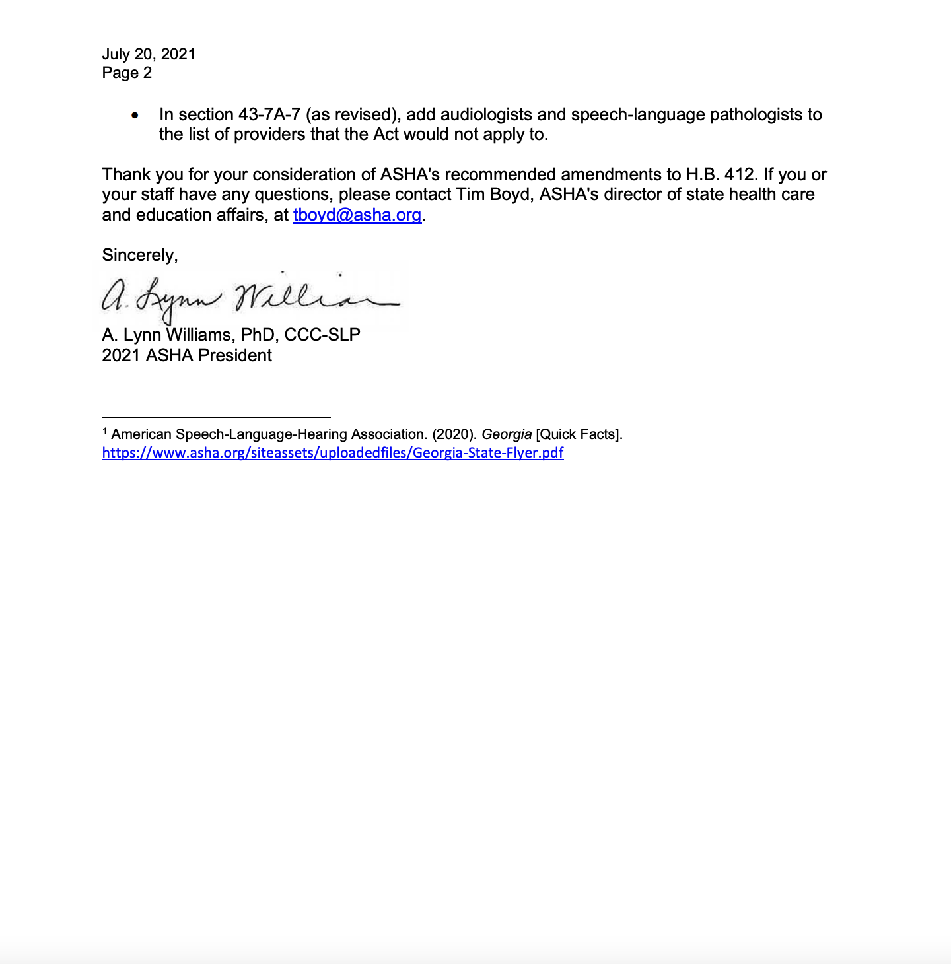

Slide 18
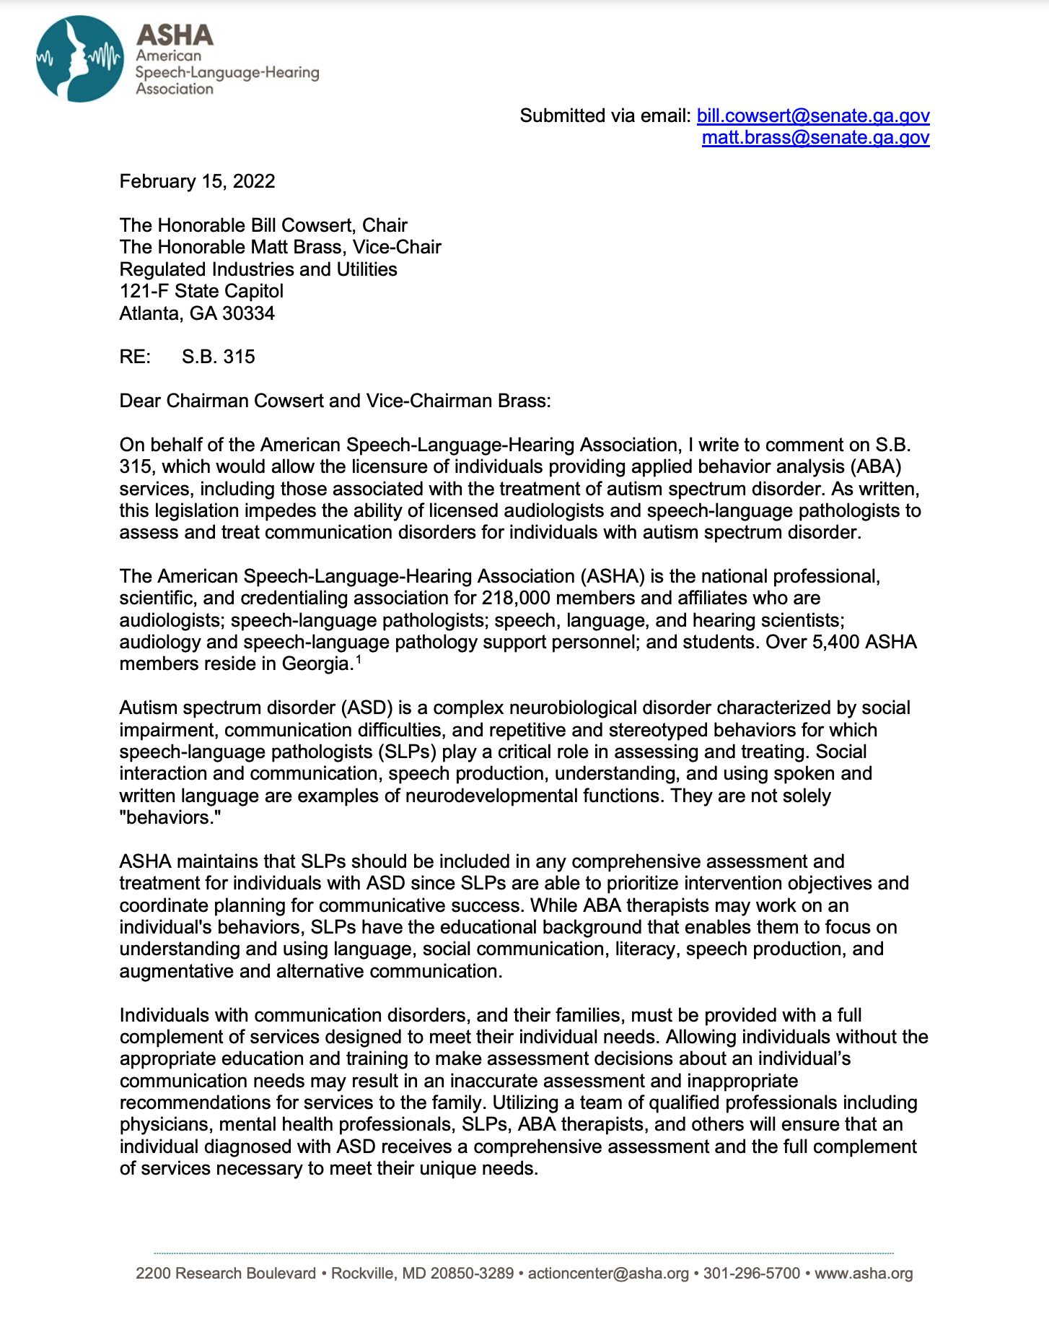

Slide 19
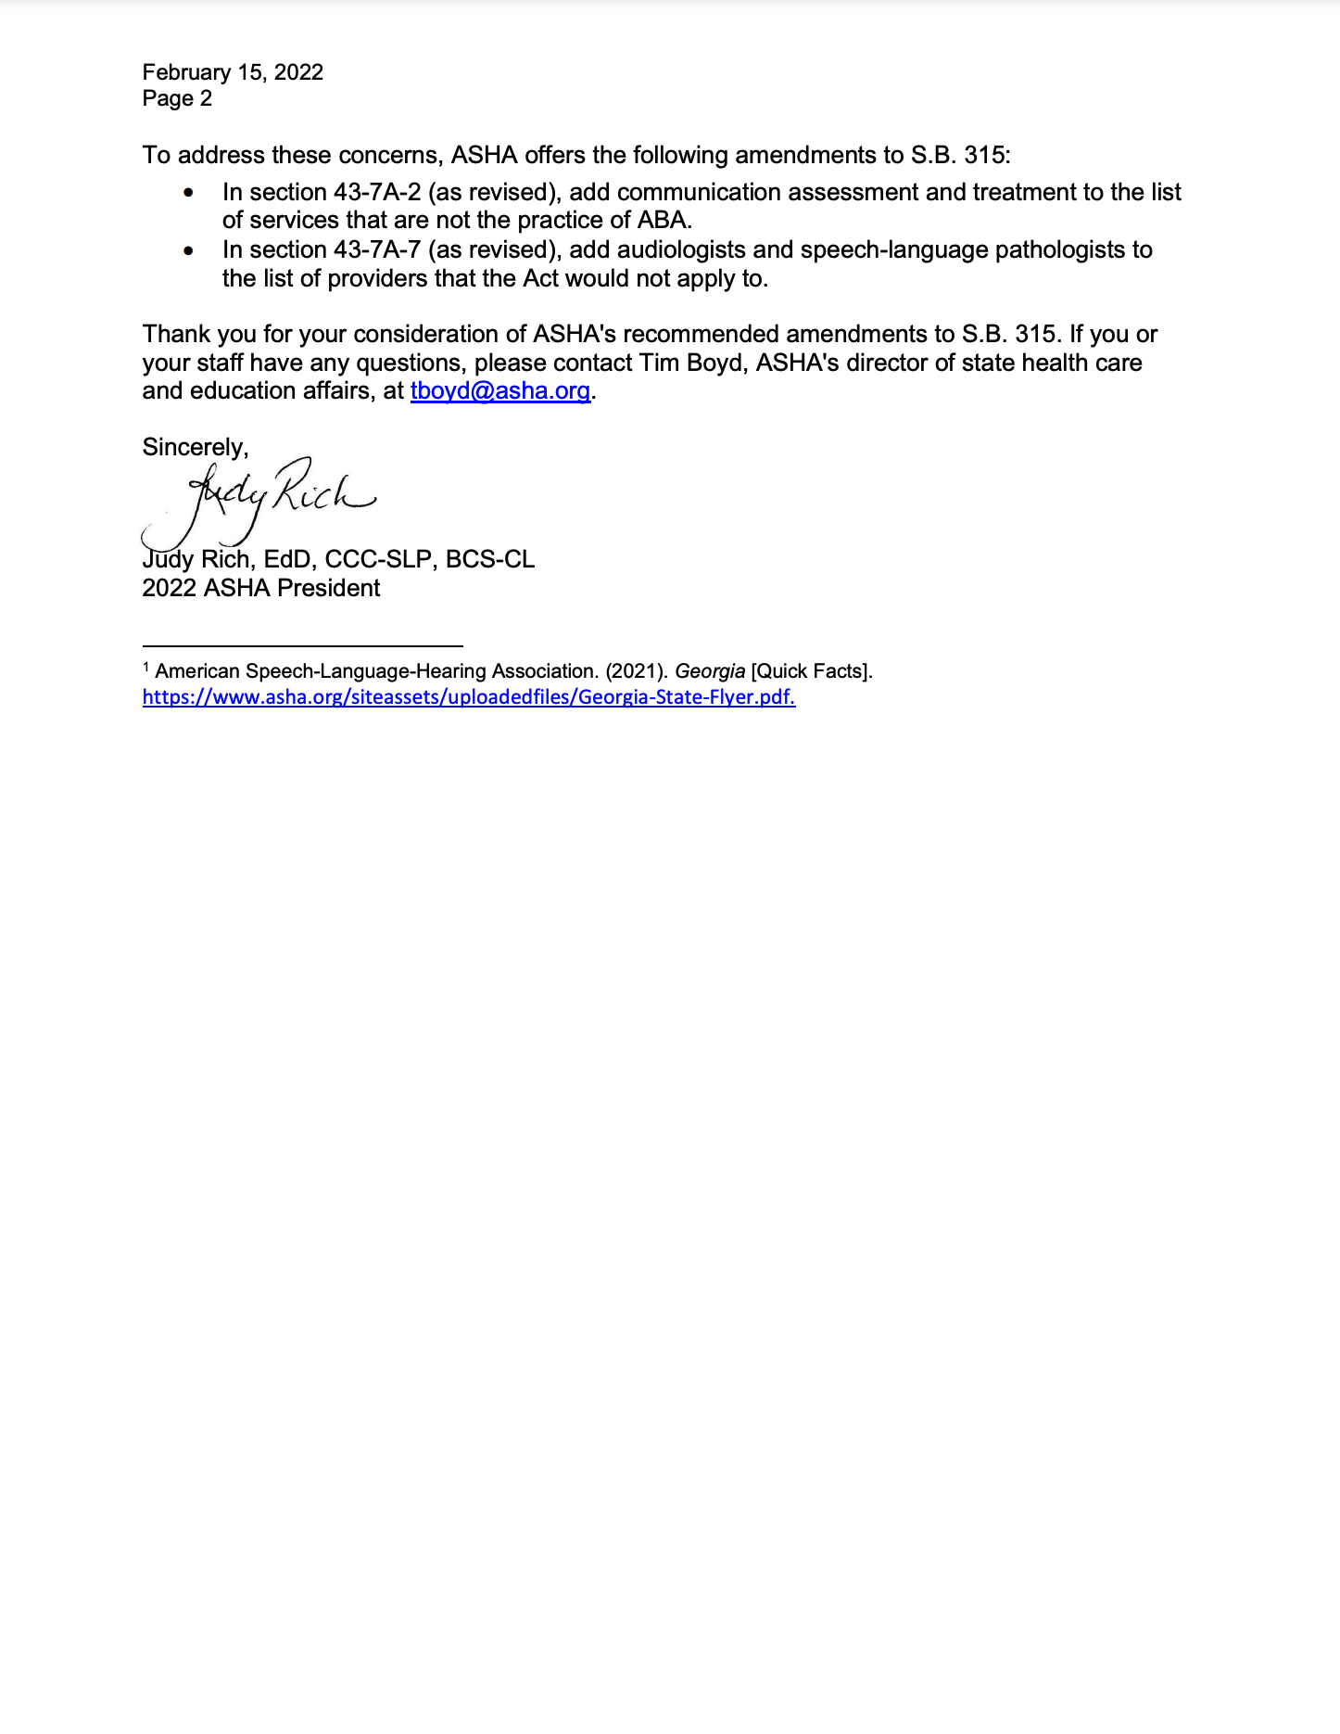

Slide 20
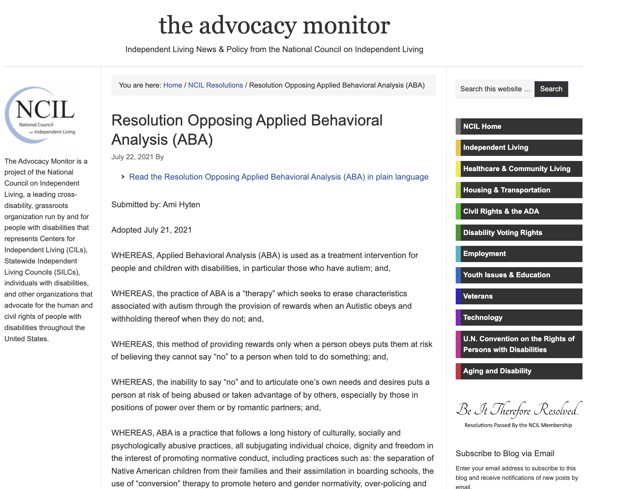
Objections to Licensure for Behavior
Analysts
Ethical Objections to the Practice of Applied Behavior Analysis

Slide 21
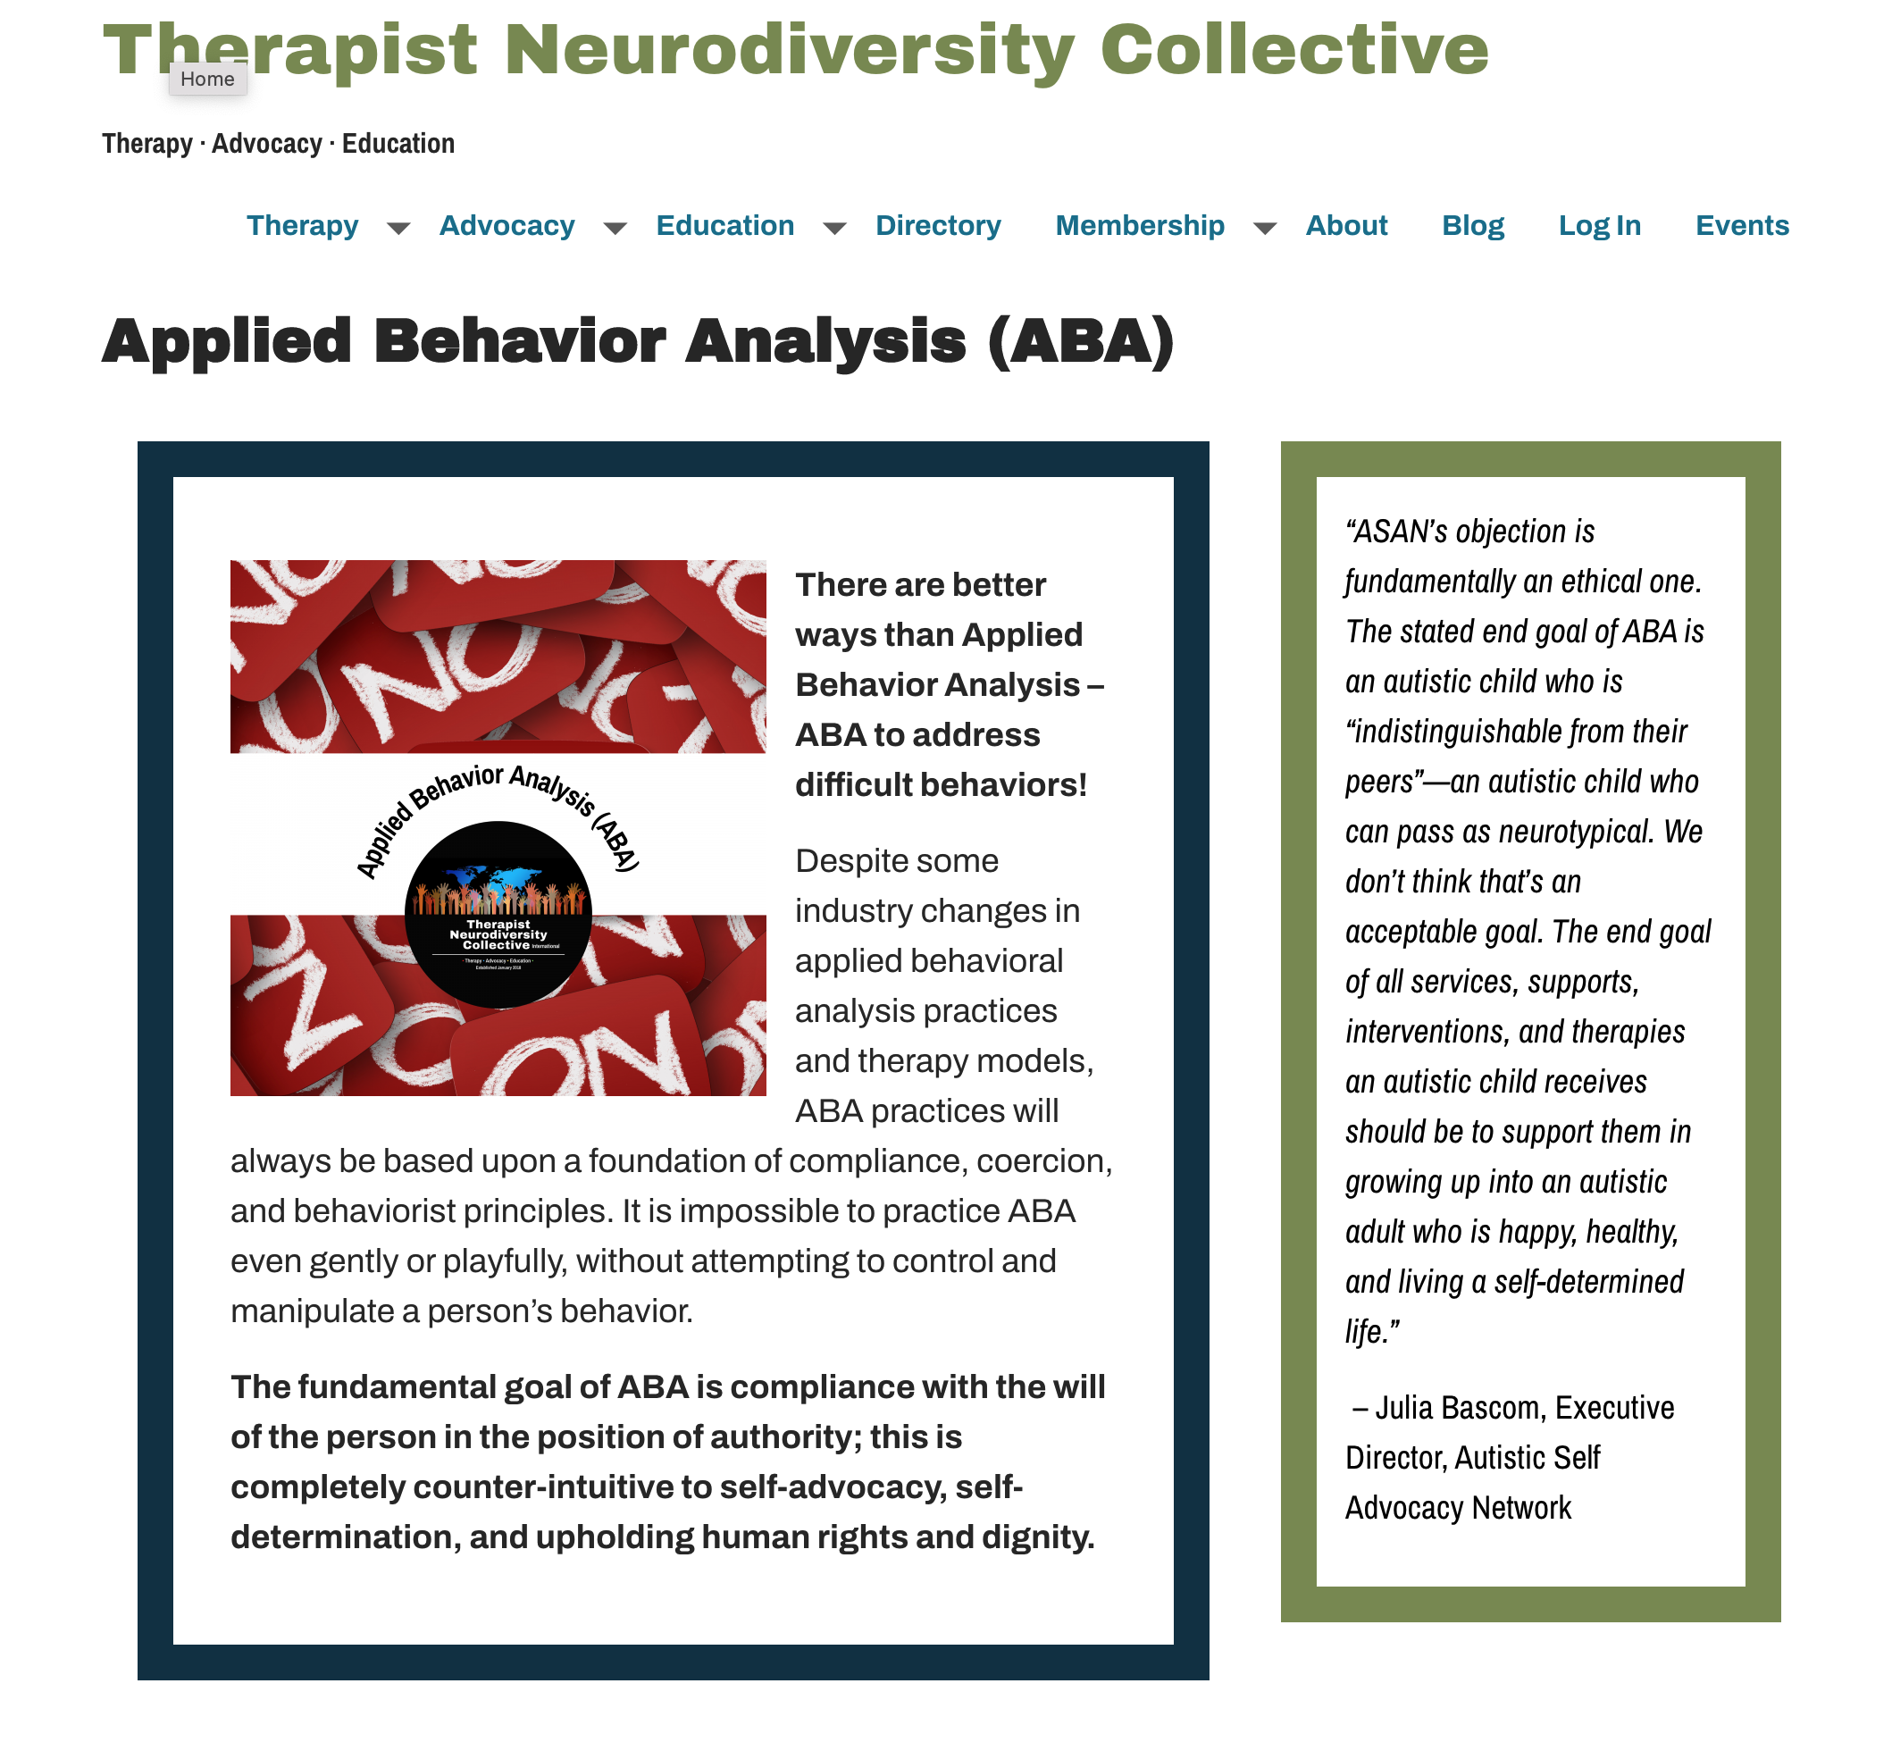
Objections to Licensure for Behavior
Analysts
Ethical Objections to the Practice of Applied Behavior Analysis

Slide 22
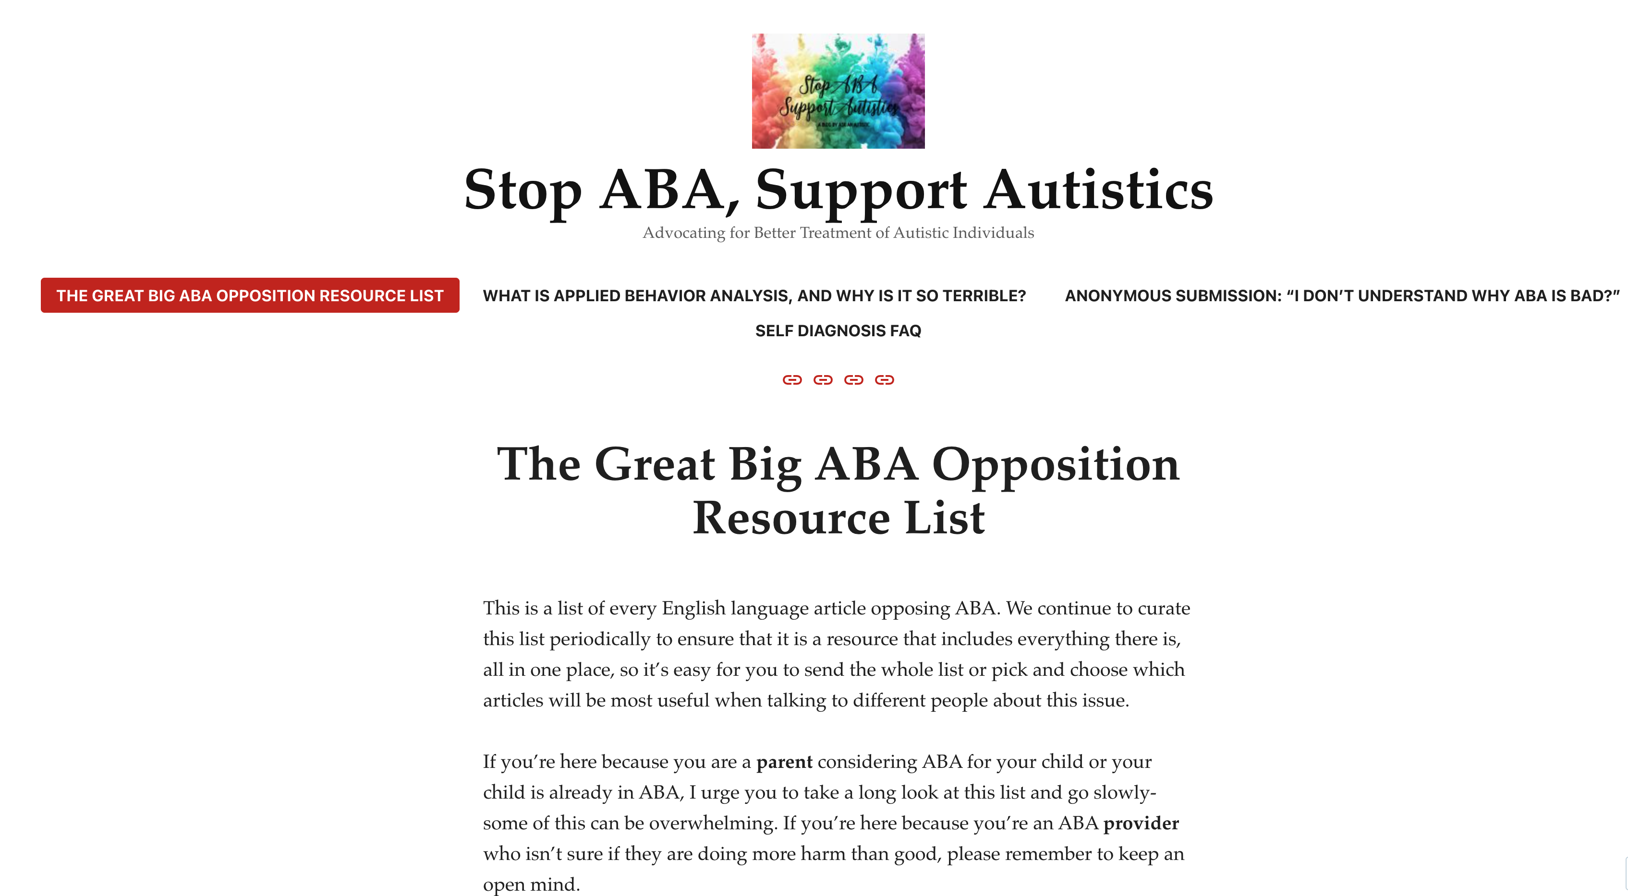
Objections to Licensure for Behavior
Analysts
Ethical Objections to the Practice of Applied Behavior Analysis

Slide 23
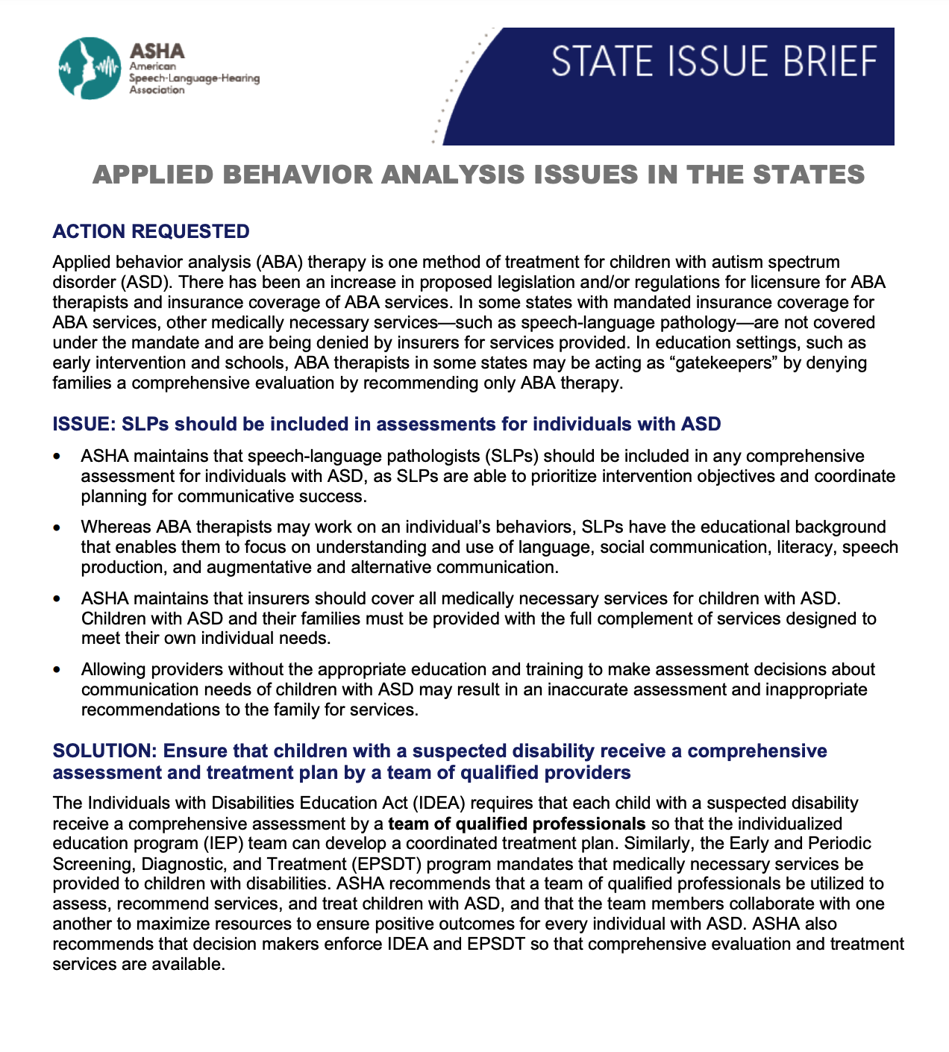
Objections to Licensure for Behavior
Analysts
Restrict Access to Care

Slide 24
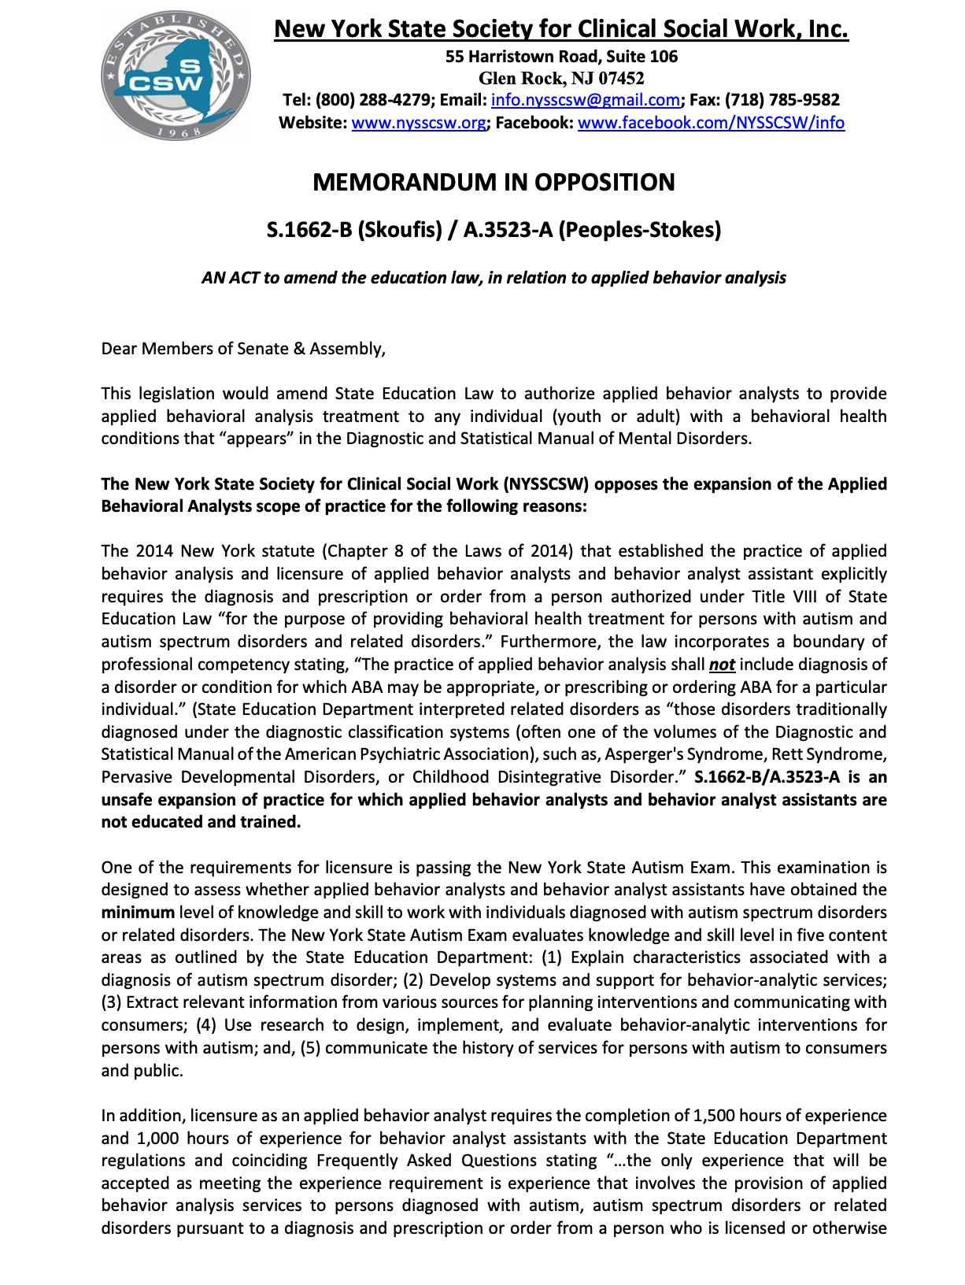
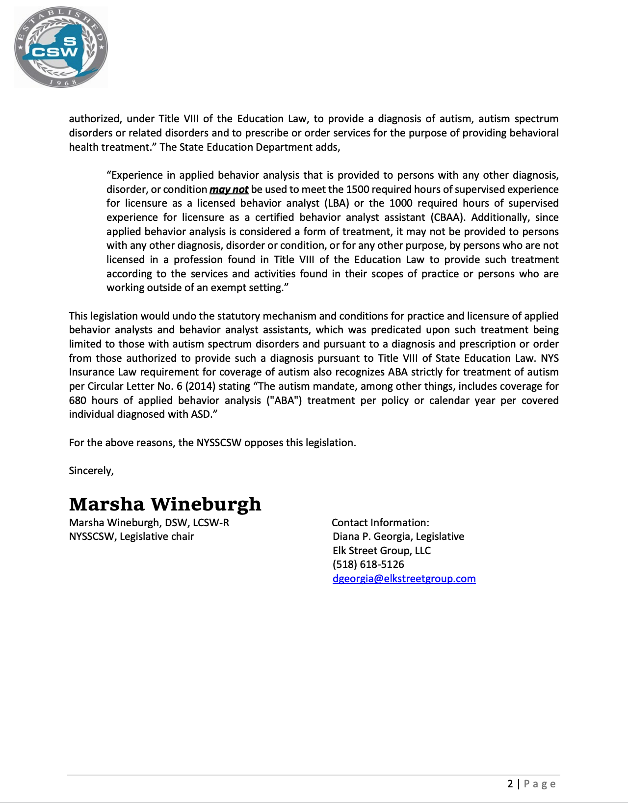
Objections to Licensure for Behavior
Analysts
Applied Behavior Analysis has too narrow a focus

Slide 25
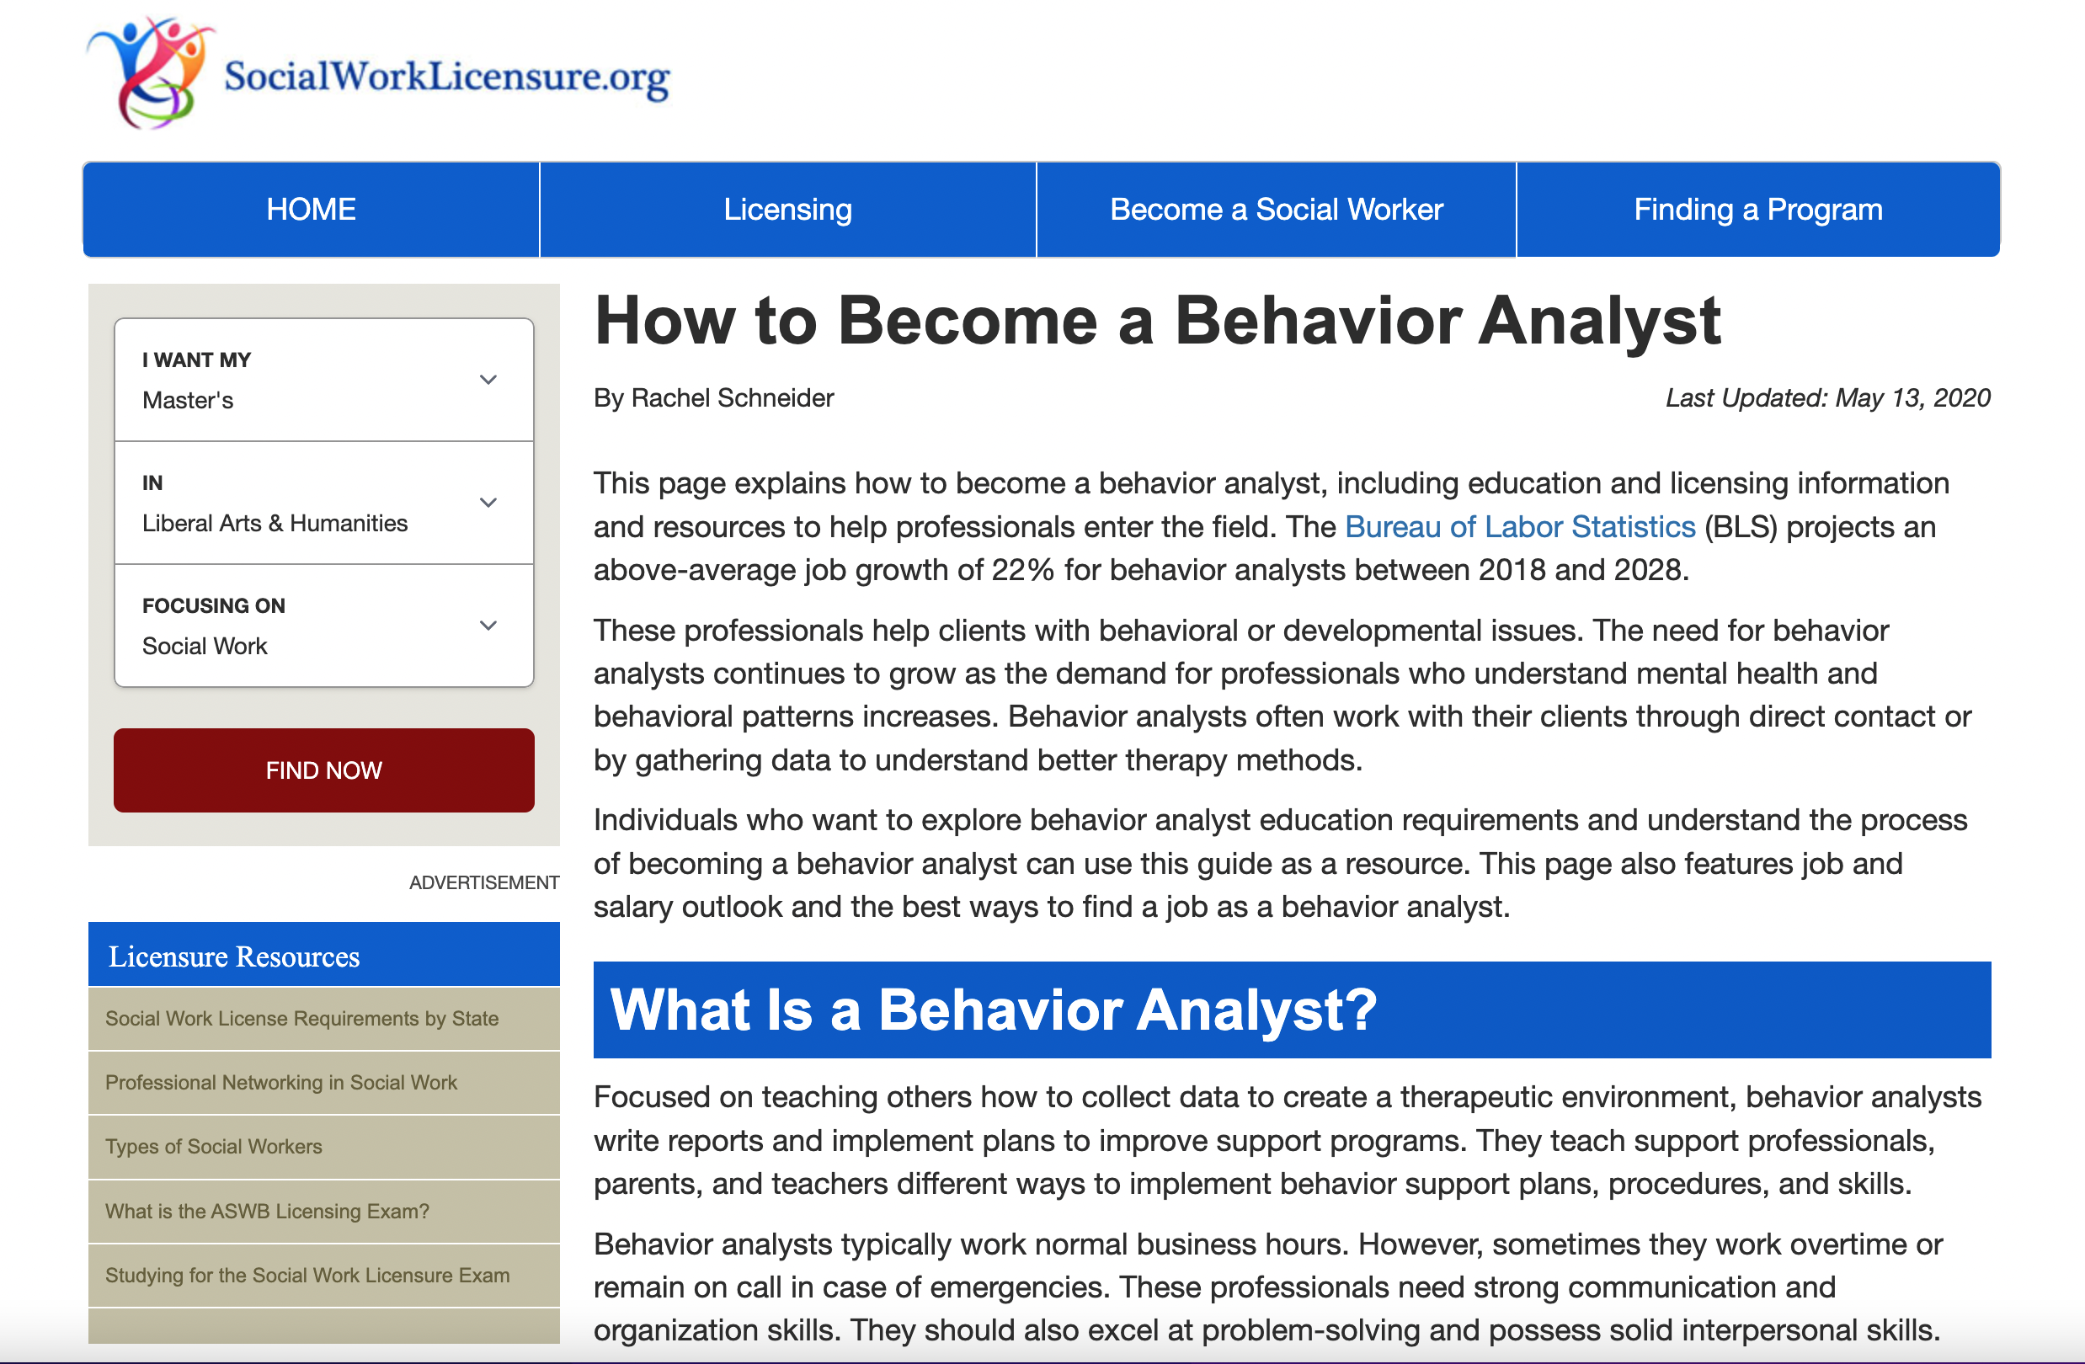

Slide 26
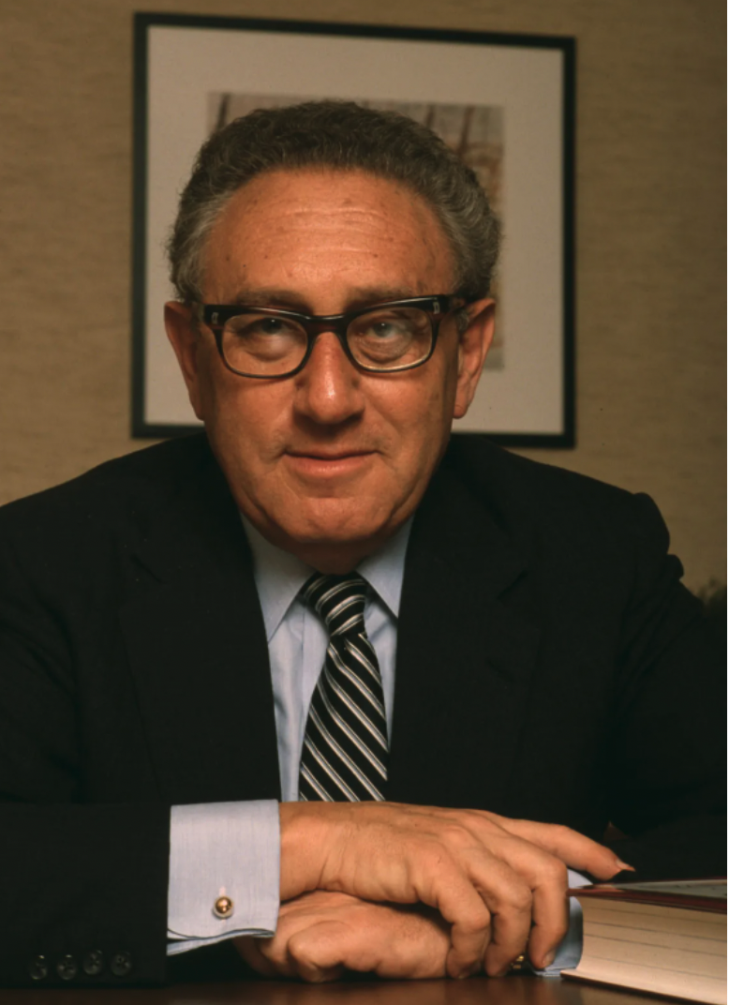
Thank You
Does anyone have any questions for my answers?
Henry Kissinger

