Slide 1
Licensure Laws and Regulations Are In Place: Now We Can Relax, Right?
Gordon Bourland, Ph.D., BCBA-D, LBA
Trinity Behavioral Associates, Arlington, TX
ABAI Licensing Committee
John Scibak, Ph.D.
Retired State Representative, Massachusetts
ABAI Licensing Committee

Slide 2
Licensure Laws and Regulations Are In Place: Now We Can Relax, Right?
Caveat:
The opinions expressed here are those of the authors and not necessarily those of any organizations with which they are associated.

Slide 3
Once a Behavior analyst licensure law is approved-
Can the law be changed?
YES
Why might the LAW be changed?
  Clarifications of wording
  Addressing new issues
  Opponents efforts to modify or abolish the existing statute

Slide 4
Once a Behavior analyst licensure law is approved-
Can the law be changed?
YES
Why might the LAW be changed?
What might that involve?

Slide 5
Once a Behavior analyst licensure law is approved-
Can the law be changed?
YES
Why might the LAW be changed?
What might that involve?
Metacontingencies????

Slide 6
Legislation & Regulations involve metacontingencies
What are metacontingencies?
- A relation between a recurring set of coordinated behaviors of two or more individuals, called an interlocking behavioral contingency (IBC) and an environmental consequence that selects and maintains the IBC so that it’s more likely to occur in the future (Glenn, 2004, 2010)
- A conglomerate of interlocking behavioral contingencies containing the behavior of multiple individuals, which generates a product that has a demand (Malott, 2003)

Slide 7
Metacontingencies in State Legislatures
Constituent
Policy Change
District Project
PAC
No District Impact
E-Mail Blast
Legislative Vote
Committee Seat
Lobbyist
Constituent Issue
Party
Leadership
Contributions
Conscience
Higher Office
Media
Party Support

Slide 8
Metacontingencies in State legislatures
SGovernor
Rep.
Sen.
Rep.
State Rep.
Mayor
SSenator
Sen.
Rep.
Sen.
SSpeaker
Senate President
Voter

Slide 9
Once a Behavior analyst licensure law is approved-
Can the law be changed?
YES
Why might the LAW be changed?
  Clarifications of wording
  Addressing new issues
  Opponents efforts to modify or abolish the existing statute
what about the REGULATIONS? Can the REGULATIONS be changed?
  YES

Slide 10
Once a Behavior analyst licensure law is approved-
Can the law be changed?
YES
Why might the LAW be changed?
  Clarifications of wording
  Addressing new issues
  Opponents efforts to modify or abolish the existing statute
what about the REGULATIONS? Can the REGULATIONS be changed?
  YES
WHY might the REGULATIONS be changed?
  Clarifications of wording
  Addressing new issues
  Opponents efforts to modify or abolish some of the existing regulations

Slide 11
But wait, …
What are regulations?

Slide 12
But wait, …
What are regulations?
Regulations provide the rules directing how a law is to be implemented.

Slide 13
But wait, …
What are regulations?
Regulations provide the rules directing how a law is to be implemented.
They specify what must be done under the authority of the law as well is what is prohibited.
They are not laws per se, but have the force of law and can be enforced by governmental entities.
They are adopted under the authority of laws and often include penalties for violations.

Slide 14
But wait, …
How are regulations made and Revised?

Slide 15
But wait, …
How are regulations made?
Governmental entities of some variety
Agency staff members
Members of oversight or advisory groups (NOTE: variations occur)
A specially designated group to draft the initial regulations, typically with staff assigned by the agency (NOTE: variations occur)

Slide 16
Once a Behavior analyst licensure law is approved-
Can the REGULATIONS be changed?
YES
Some examples of REGULATION changes?

Slide 17
Once a Behavior analyst licensure law is approved-
Can the REGULATIONS be changed?
YES
Why might the REGULATIONS be changed?
What might that involve?
Metacontingencies????

Slide 18


Slide 20
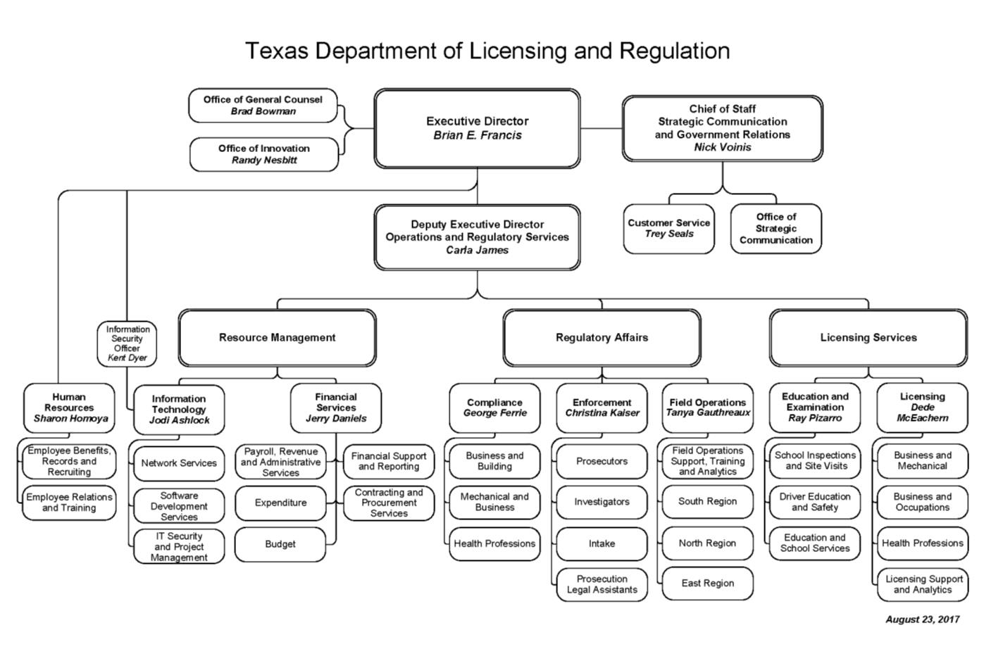



Slide 21
Metacontingencies in Executive Branch Agencies
Governor
Policy Change
Legislators
Lobbyist
Statutory Changes
Constituents
Governing Board/ Cabinet Secretary
Public Testimony
Licensing Board Appointments
Other Executive Agencies
Regulatory Change
Advisory/Licensing Board Members
Media
Agency Director

Slide 22
What should behavior analysts do in light of these possibilities of changes in the law and/ or regulations?

Slide 23
What should behavior analysts do in light of these possibilities of changes in the law and/ or regulations?
Monitor CLOSELY-

Slide 24
What should behavior analysts do in light of these possibilities of changes in the law and/ or regulations?
Monitor CLOSELY-
  any proposed changes and provide comment regarding them.
  meetings of the regulatory bodies involved with licensure
    to stay informed with decisions and ongoing discussion as well as to provide direct and specific input regarding issues that should be considered by the body
  possible activities of other governmental entities and other professions that could have an impact on behavior analysts and their licensure and be prepared to address those activities

Slide 25
But wait, …
How are regulations Revised?
Governmental entities of some variety
Agency staff members
Members of oversight or advisory groups
A specially designated group to draft the initial regulations, typically with staff assigned by the agency

Slide 26
Go beyond just monitoring?

Slide 27
Go beyond just monitoring
Provide input regarding possible changes
Utilize multiple forms of input:
- Direct, collegial interaction with persons who can make changes of interest and their staff. Often this is informal
- Capitalize on public comment opportunities regarding draft policies and organizational changes, in writing and orally

Slide 28
Go beyond just monitoring
Nature/ content of the input
- Proceed based upon presumption of rational, good faith interactions
- Comment clearly and succinctly (this is not a dissertation project!)
- Avoid accusatory and ad hominem comments (no, “Jane, you ignorant slut!” type comments)
- State clearly what you recommend. State it succinctly at the beginning (after identifying yourself) and at the conclusion. Between those statements, provide the rationale for the recommendation.
- Keep the actual comments relatively short (for written comment, ideally 2-3 pages). Include via an attachment or a verbal statement an offer to provide- more detailed development of the rationale for the recommendation
- In oral testimony, tell the story!!

Slide 29
Go beyond just monitoring
Who should provide input?
- Behavior analysts living and/ or working in the jurisdiction
- Lobbyists, where appropriate
- Stake holders including service recipients, constituents of elected office holders, service providers, advocacy groups, etc.
- Provide the facts but also “grab their hearts” with people who can tell a story that the audience and the media will never forget
- Judiciously use “heavy hitters” such as financial donors to elected office holders

Slide 30

So now that we’ve attended to Licensure Laws and Regulations, Now We Can Relax, Right?

Slide 31


So now that we’ve attended to Licensure Laws and Regulations, Now We Can Relax, Right?
Don’t forget SunseT!!

