Slide 1
We Have A Behavior Analyst Licensure Law- Can’t We Relax Now?

Slide 2
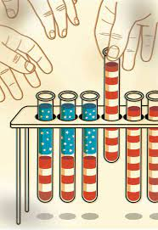
Disseminate
Today, more scientists recognize the limits of this tradition and removing beyond publication to communicate the results to the wider world.
Journals are too complicated, too technical, and do not deliver to the door steps.
Science and democracy have always been twins.

Slide 3

Influence
So many of the issues we confront have to do a science, and if people aren’t informed, they can’t be good citizens. New York Times Corey Dean.
Scientist are sometimes like American tourists; we think if we just speak English loud enough, people will understand us.
This is not translated to the wider world.
People generally make up their minds by many more subtle, less rational factors (vaccines).

Slide 4

Cut through the Noise
Scientists know too much and struggle to simplify it.
Policymakers need help cutting through the noise.
This is why they are not interested in the details of your science, they want to know what it means for the decisions they must make.

Slide 5

Policymakers
Policymakers in high-level bodies hardly suffer from lack of information, they have too much to start with.
Understanding the policymakers culture can open doors and help scientists gain a seat at the policymaking table.

Slide 6
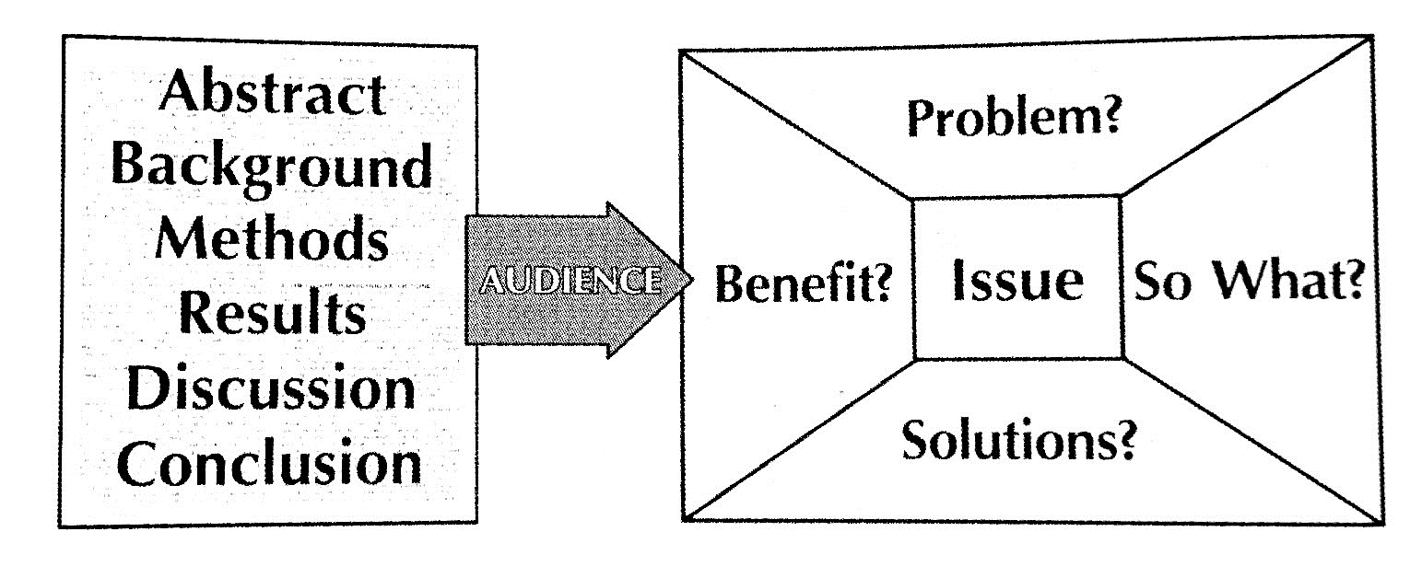
The Message Box

Slide 7
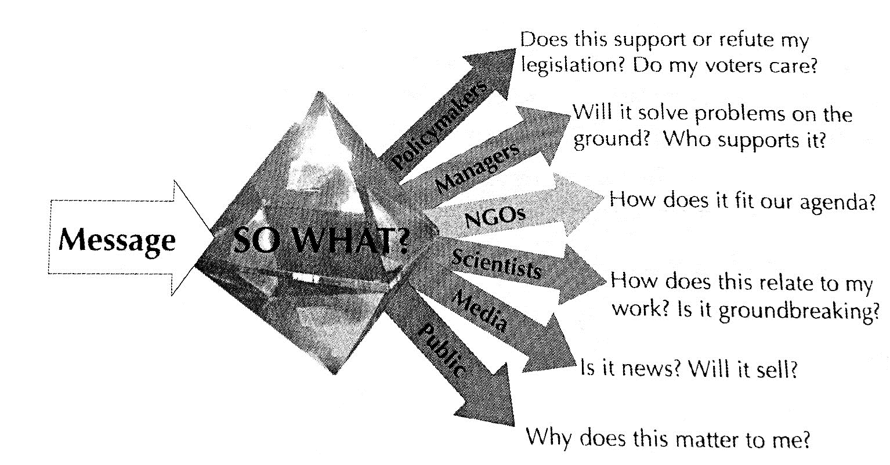

Slide 8
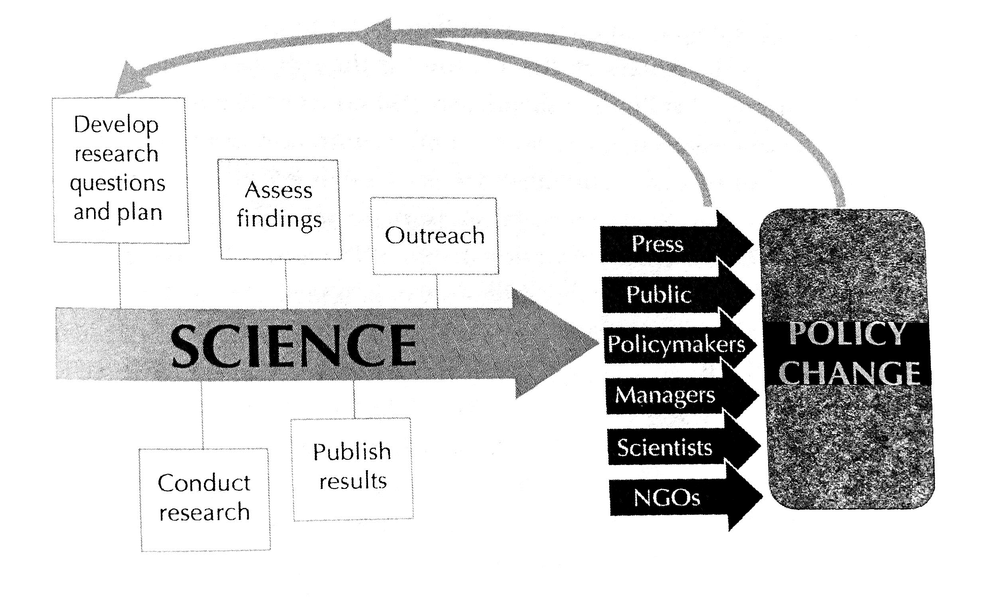

Slide 9
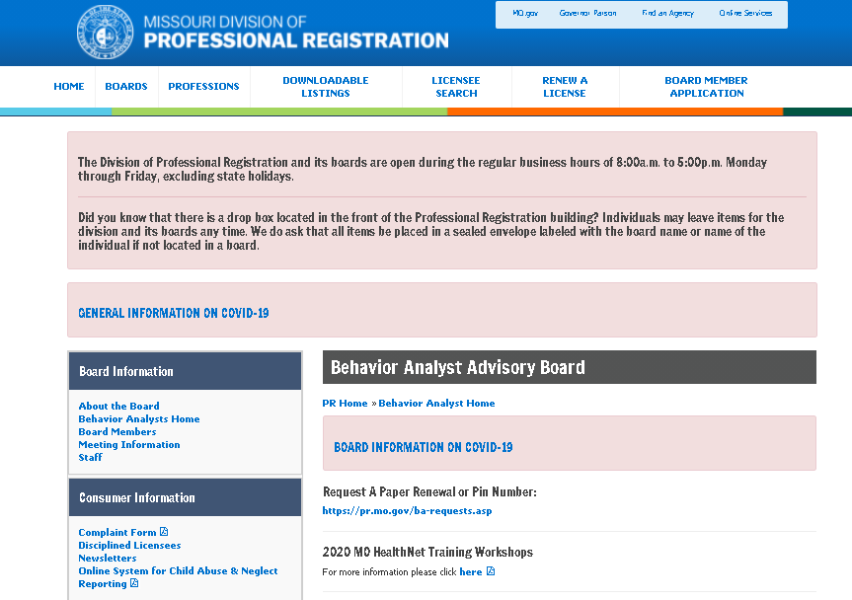
The Board

Slide 10
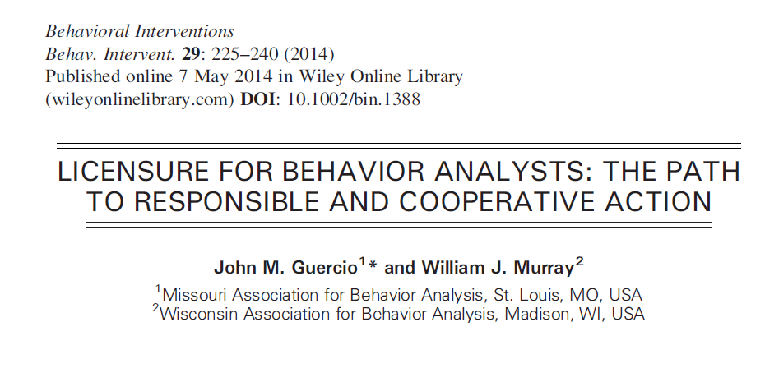
Reference Material

Slide 11
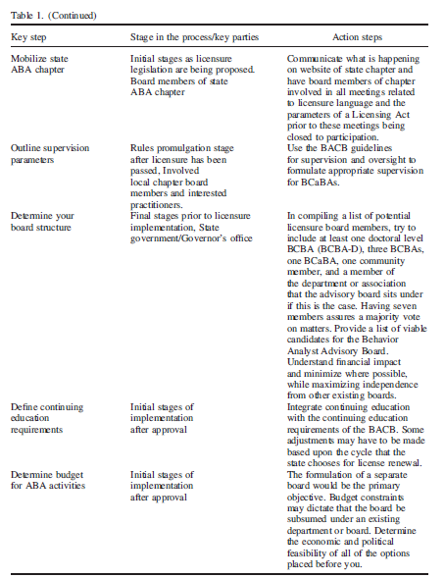

Slide 12
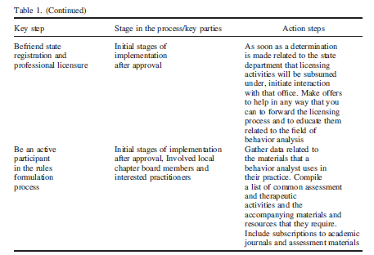
More Recommendations

Slide 13
The Details
Brick.
Recent changes by DESE.
MARF involvement.
Allies in Dept. of Processional Regulation.
Independent boards are not a reality in most states.
Be ready to deconstruct your entire day/week/year.

Slide 14
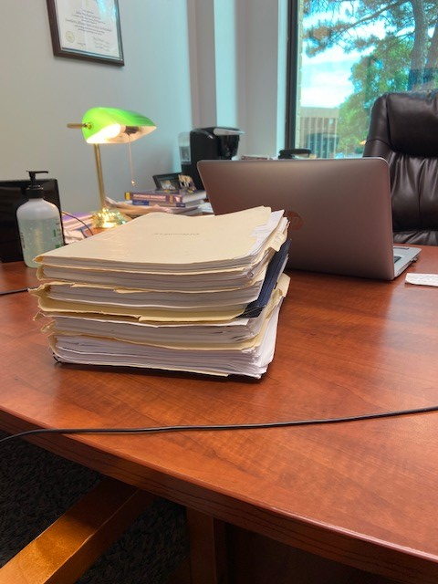
Rules Promulgation

Slide 15
Questions & Discussion

